Slide 1





SAFETY – Simulation Approach For Education and Training in emergencY
WP2 – Students and Academics needs
Action Plan and Questionnaires Presentation
WP2 meeting - 22 January 2021
Fedele Colantuono and Francesco Barberio
University of Foggia, Italy
The European Commission's support for the production of this publication does not constitute an endorsement of the contents, which reflect the views only of the authors, and the Commission cannot be held responsible for any use which may be made of the information contained therein.
Partner logo

Slide 2

ACTION PLAN FOR STUDENTS AND ACADEMICS NEEDS SURVEY
Contents
Introduction
Key topics of the survey
Target groups
The survey instrument
The questionnaire structure and layout
Methodologies and statistical analysis
Survey management and sampling plan
Preparation of the database of answers and data analysis
WP2 meeting, 22-01-2021 Page 02
Partner logo

Slide 3

ACTION PLAN FOR STUDENTS AND ACADEMICS NEEDS SURVEY
Introduction
brief SAFETY project aims
to better understand target groups perception/view and the conceptual boundaries of the current educational offer and related methods/contents
to define WHAT to evaluate, HOW to do it, WHEN to carry out the survey
process, WHO involve , which METHOD to drop the evaluation
Key topics of the survey
survey main objectives
main aspects to investigate through the surveys
WP2 meeting, 22-01-2021 Page 02
Partner logo

Slide 4


ACTION PLAN FOR STUDENTS AND ACADEMICS NEEDS SURVEY
Target groups
STUDENTS
Nurses: 3rd year (3 years whole duration degree)
Medicine students: 5th and 6th year
(6 years whole duration degree )
Residents
Fellows
Trainees
Doctors in training
Professionals
ACADEMICS & EXPERTS
Attendings
University professors (from HEIs in the field of medicine and health care)
Lecturers
Researchers
Trainers (with at least 10 years of experience who train other workers )
STUDENTS
500 surveys/country
ACADEMICS & EXPERTS
80-100 surveys/country
Numbers expected
The survey instrument
Google form
WP2 meeting, 22-01-2021 Page 04
Partner logo

Slide 5
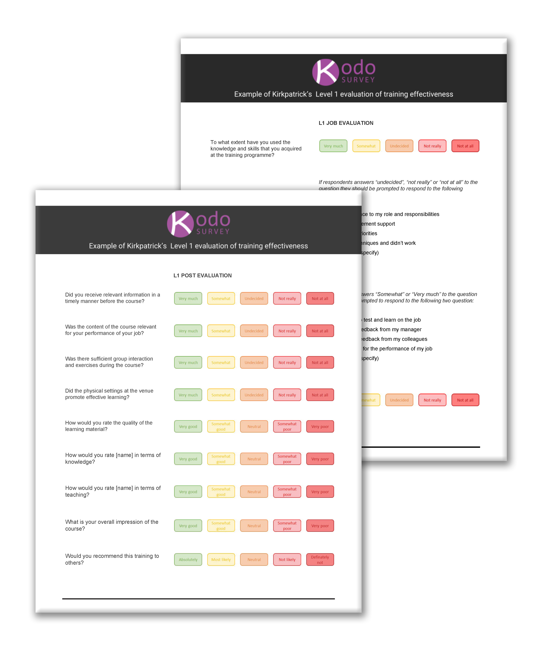
ACTION PLAN FOR STUDENTS AND ACADEMICS NEEDS SURVEY
The questionnaires structure and layout
1st section: opinions on Emergency educational system in general and own availability (readiness) to employ advanced simulation tools for learning.
2nd section: choices about the preference selection on alternatives conveying information about
i) three categories of technical skills;
ii) if no technical skills are needed;
iii) the method to supply the course among e-learning, face-to-face and hybrid modes;
iv) possible feedback needed;
v) the duration of the course expressed in hours;
vi) and the price one would be willing to pay for such a course.
3rd section: demographic and socio-economic aspects, portraying the respondent profiles. Eight questions are posed regarding: 1) gender; 2) age; 3) respondents residence; 4) country where they work (study); 5) activity carried out; 6) year of the course being enrolled; 7) Medicine sector dealing with; 8) income category.
WP2 meeting, 22-01-2021 Page 05
Partner logo

Slide 6



ACTION PLAN FOR STUDENTS AND ACADEMICS NEEDS SURVEY
Methodologies and statistical analysis
Choice Experiment and Latent Class Model in order to investigate cluster parameters for sample segmentation and finally understand preferences heterogeneity across classes.
target groups needs will drive to seize the structure of the course turned into enhanced skills and capabilities.
to grab the willingness to spend money for the SAFETY course, in terms of project outputs exploitation and related sustainability beyond the project lifetime (recommended by the Erasmus+ programme).
WP2 meeting, 22-01-2021 Page 06
Partner logo

Slide 7

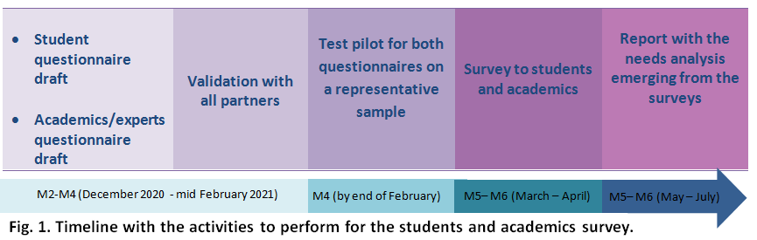


ACTION PLAN FOR STUDENTS AND ACADEMICS NEEDS SURVEY
Survey management and sampling plan
Survey National Coordinators
UniFg survey team
WP2 meeting, 22-01-2021 Page 07
Partner logo

Slide 8
Thank you!
www.safetymedsim.eu

