Slide 1




WP2: Updates on the survey results
…………………………….
Fedele Colantuono
Francesco Barberio
Gianluigi De Pascale
Ruggiero Sardaro
UniFg team
20-07-2021
The European Commission's support for the production of this publication does not constitute an endorsement of the contents, which reflect the views only of the authors, and the Commission cannot be held responsible for any use which may be made of the information contained therein.

Slide 2

Students and Academics Surveys
Our goals:
At least 500 students from each country involved in the project
At least 100 academics from each country involved in the project
Start: 22-03-2021
End: 31-05-2021 postponed to 15-06 2021
Page 02

Slide 3
Students and Academics Surveys
Language Version | Students | Academics
English | 9 | 2
German | 255 | 17
Italian | 312 | 92
Norwegian | 24 | 14
Portuguese | 6 | 1
Romanian | 534 | 52
Spanish | 324 | 110
TOTAL | 1464 | 288
Page 03

Slide 4
Students Survey
ITA | 312
ENG | 9
GER | 255
NOR | 24
POR | 6
ROM | 534
SPA | 324
18-25 | 1008
26-32 | 321
33-50 | 120
>50 | 15
Page 04

Slide 5
Students Survey
School Med. | 980
School Nurse | 255
Others | 229
M | 435
F | 1029
Page 05

Slide 6
Academics Survey
ITA | 92
ENG | 2
GER | 17
NOR | 14
POR | 1
ROM | 52
SPA | 110
25-30 | 26
51-50 | 169
>50 | 93
Page 06

Slide 7
Academics Survey
Tutor | 80
Specialist | 73
Researcher | 40
Prof | 95
M | 135
F | 153
Page 07

Slide 8
Summary of the Surveys
  Q1F Training received
  Q1U University educational offer
  Q1O Opinion about educational offer
35 questions : 1) Agreement on the Educational offer (10q)
              2) Team work (5q)
              3) Confidence in Emergency Team (Non-Tech) (5q)
              4) Management of different Emercencies (6q)
              5) Technical Skills (8q)
              6) Learning in Simulation (1q)
              6 tables of choice
              8 demographics
Q2
Q3
Q4
Q5
Q6
Page 08

Slide 9
Coding
ATT 1 | Technical skill 1 - Laboratory results and imaging interpretation
ATT 2 | Technical skill 2 - Emergency management (CPR, Trauma patient, Shocked patient, Respiratory Failure, Obstetric Patient etc)
ATT 3 | Technical skill 3 - Monitoring devices and lines and catheter management
ATT 4 | Non-technical skill 1 – Crisis Resource Management
ATT 5 | Non-technical skill 2 - Team leading and team working
ATT 6 | Hybrid course (face-to-face + e-learning course)
ATT 7 | Feedback
ATT 8 | Duration (hours)
Page 09

Slide 10
Guide to interpret the results
Consider the question of the survey you are referring to 🡪 for example, Q1 has 10 sub-questions
Can be the sub-questions grouped based on similarities? We use the factor analysis to do this
  If Yes, we are considering the Q1 which is splitted into two main categories 🡪 Q1F: Training received; Q1U: University Educational Offer
  If No, we are considering the Questions 3, 4, 5
  Question n. 2 is not significat at all, therefore the results are not presented
  Question n. 6 is a straight question, so sub-groups are not allowed
Focus on a specific question (category from factor analysis). How does it vary? Has its positive variation an impact on each of the eight attributes (ATT*) being assessed for understanding the preference of the respondents?
The Tables at pages n. 10 and n. 19 JUST indicate that all the attributes are relevant. Please check just the significance of the coefficients and do not focus on the magnitude and any impact
Page 09

Slide 11
Guide to interpret the results
Read the table with results from page n.11 for the student’s survey and from page n. 20 for the academic’s survey 🡪 e.g., Q6 (page 16 – student’s survey) is like to reply the following question “What is the importance that you recognise to the learning done with using simulation devices?”. FROM the Table: ATT*:QU6 🡪 STEPS FOR GENERAL INTERPRETATION:
Consider only the significance coefficient (for socio-economic analysis the confidence interval (C.I.) is accepted even at 90%) that are indicated with asterisks 🡪 * 10% significance level (90% C.I.); ** 5% significance level (95% C.I.); *** 1% significance level (99% C.I.). In our example there are two significant coefficients and are in correspondence of ATT2 and ATT6;
At the increase of one category (in that case) of the level of importance recognised to the learning supplied by employing simulation devices, what is the preference for the attribute being considered? The sign provides information on the versus of the preference, the coefficient about the intensity of such preference. In our example, the more the learning supplied by simulation devices is deemed useful, the more the technical skill n. 2 (ATT2) is preferred; and the more the learning supplied by simulation devices is deemed useful, the less the e-learning solution is not considered suitable;
Elaborate your (potential) IMPLICATION(s) 🡪 i) Simulation tools are perceived suitable to learn the technical skill n. 2 or the context in which the learning is supplied with simulation tools is perceived suitable to supply the technical skill n. 2; ii) The learning with simulation tools is perceived to be undertaken in presence; this being perhaps dependent on several reasons, such as the state of the art of the virtual tools is not considered adequate and needs to be further developed; the respondents have no proper background to manage virtual simulation tools.
Page 09

Slide 12
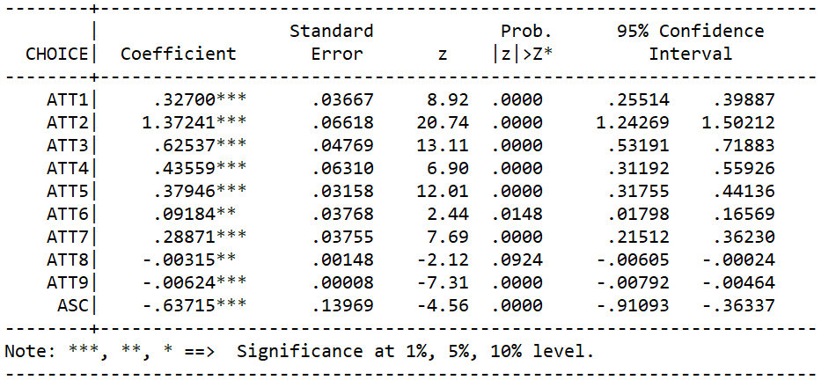
ATT 1 | Technical skill 1
ATT 2 | Technical skill 2
ATT 3 | Technical skill 3
ATT 4 | Non-technical skill 1
ATT 5 | Non-technical skill 2
ATT 6 | Hybrid course
ATT 7 | Feedback
ATT 8 | Duration
Student’s Results
Page 10

Slide 13
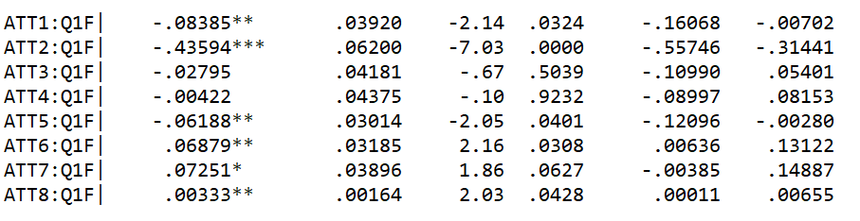
ATT 1 | Technical skill 1
ATT 2 | Technical skill 2
ATT 3 | Technical skill 3
ATT 4 | Non-technical skill 1
ATT 5 | Non-technical skill 2
ATT 6 | Hybrid course
ATT 7 | Feedback
ATT 8 | Duration
Student’s Results
  Q1F Training received
+ Training received: Less Tech Skills 1 required
        Less Tech Skills 2 required
        Less N-Tech Skills 2 required
        More e-learning courses required
        More feedback required
        More hours for courses required
Page 11

Slide 14
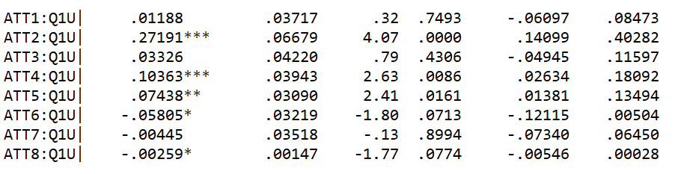
ATT 1 | Technical skill 1
ATT 2 | Technical skill 2
ATT 3 | Technical skill 3
ATT 4 | Non-technical skill 1
ATT 5 | Non-technical skill 2
ATT 6 | Hybrid course
ATT 7 | Feedback
ATT 8 | Duration
Student’s Results
  Q1U University Educational Offer
+ UES received: More Tech Skills 2 required
        More N-Tech Skills 1 required
        More N-Tech Skills 2 required
        Less e-learning courses required
        Less hours for courses required
Page 12

Slide 15
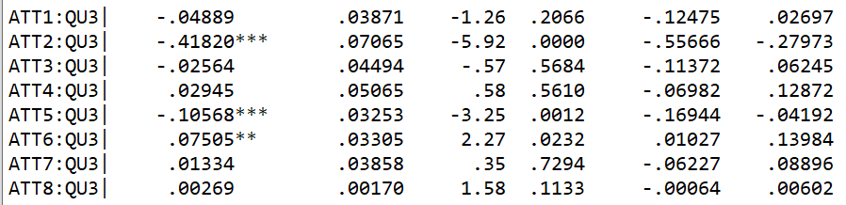
ATT 1 | Technical skill 1
ATT 2 | Technical skill 2
ATT 3 | Technical skill 3
ATT 4 | Non-technical skill 1
ATT 5 | Non-technical skill 2
ATT 6 | Hybrid course
ATT 7 | Feedback
ATT 8 | Duration
Student’s Results
  Q3 Confidence in Emergency Team (Non-tech)
+ Confidence in Emergency Team (Non-tech) received: Less Tech Skills 2 required
        Less N-Tech Skills 2 required
        More e-learning courses required
Page 13

Slide 16
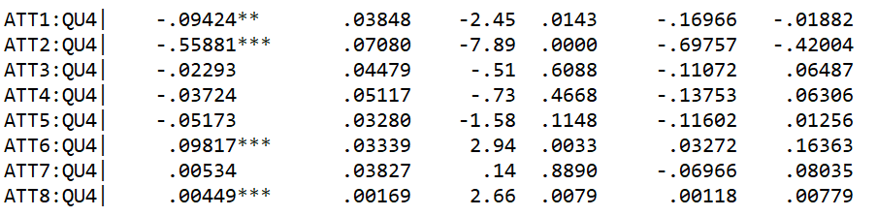
ATT 1 | Technical skill 1
ATT 2 | Technical skill 2
ATT 3 | Technical skill 3
ATT 4 | Non-technical skill 1
ATT 5 | Non-technical skill 2
ATT 6 | Hybrid course
ATT 7 | Feedback
ATT 8 | Duration
Student’s Results
  Q4 Management of different Emercencies
+ Management of different Emercencies received: Less Tech Skills 1 required
        Less Tech Skills 2 required
        More e-learning courses required
        More hours for courses required
About What?
Page 14

Slide 17
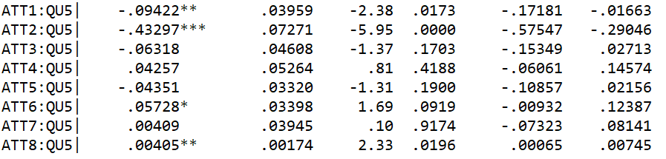
ATT 1 | Technical skill 1
ATT 2 | Technical skill 2
ATT 3 | Technical skill 3
ATT 4 | Non-technical skill 1
ATT 5 | Non-technical skill 2
ATT 6 | Hybrid course
ATT 7 | Feedback
ATT 8 | Duration
Student’s Results
  Q5 Technical Skills
+ Tech Skills received: Less Tech Skills 1 required
        Less Tech Skills 2 required
        More N-Tech Skills 2 required
        More hours for courses required
About What?
Page 15

Slide 18

ATT 1 | Technical skill 1
ATT 2 | Technical skill 2
ATT 3 | Technical skill 3
ATT 4 | Non-technical skill 1
ATT 5 | Non-technical skill 2
ATT 6 | Hybrid course
ATT 7 | Feedback
ATT 8 | Duration
Student’s Results
  Q6 Learning in Simulation
+ Learning in Simulation received: More Tech Skills 2 required
        Less e-learning courses required
Page 16

Slide 19
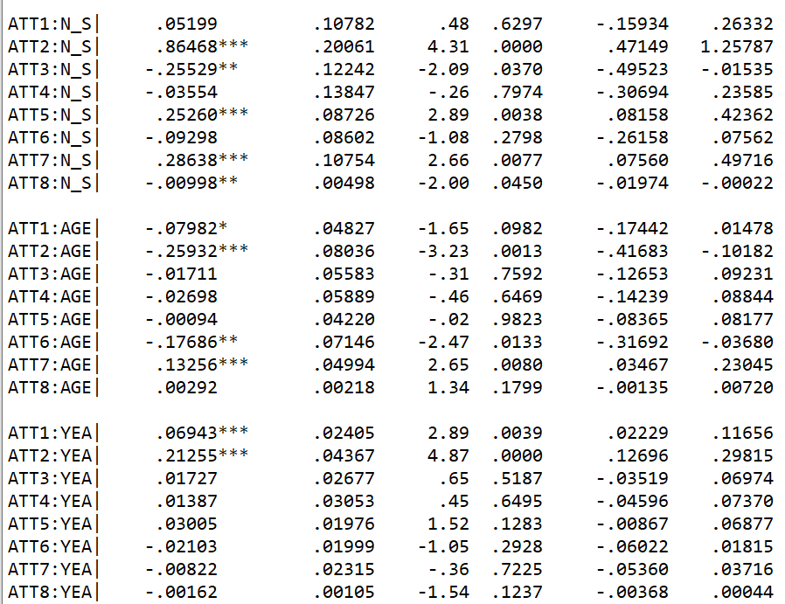
ATT 1 | Technical skill 1
ATT 2 | Technical skill 2
ATT 3 | Technical skill 3
ATT 4 | Non-technical skill 1
ATT 5 | Non-technical skill 2
ATT 6 | Hybrid course
ATT 7 | Feedback
ATT 8 | Duration
Student’s Results
Nord vs South: More Tech Skills 2 required
        (Ger-Nor) Less Tech Skills 3 required
        More N-Tech Skills 2 required
        More feedback required
        Less hours required
+ Age: Less Tech Skills 1 required
        Less Tech Skills 2 required
        Less e-learning courses required
        More feedback required
+ Year of study: More Tech Skills 1 required
        More Tech Skills 2 required
Page 17

Slide 20
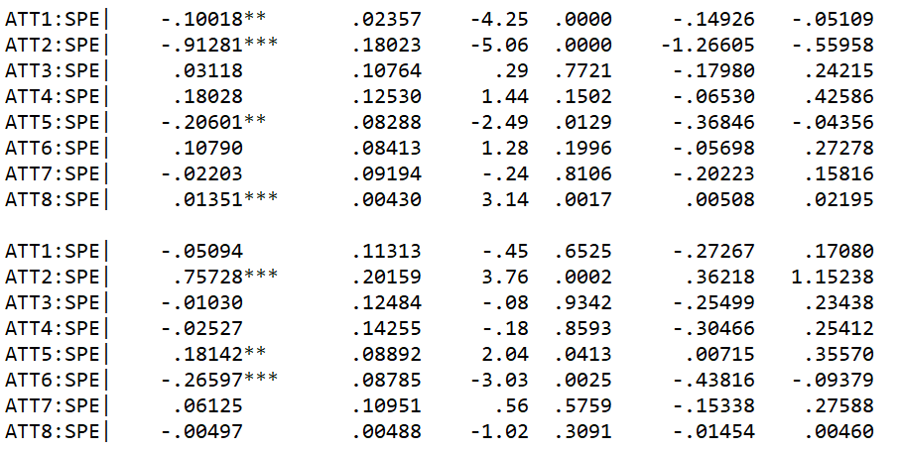
ATT 1 | Technical skill 1
ATT 2 | Technical skill 2
ATT 3 | Technical skill 3
ATT 4 | Non-technical skill 1
ATT 5 | Non-technical skill 2
ATT 6 | Hybrid course
ATT 7 | Feedback
ATT 8 | Duration
Student’s Results
Nurse vs Med: Less Tech Skills 1 required
        Less Tech Skills 2 required
        Less N-Tech Skills 2 required
        More hours required
Other vs Med: More Tech Skills 2 required
        More N-Tech Skills 2 required
        Less e-learning courses required
Page 18

Slide 21
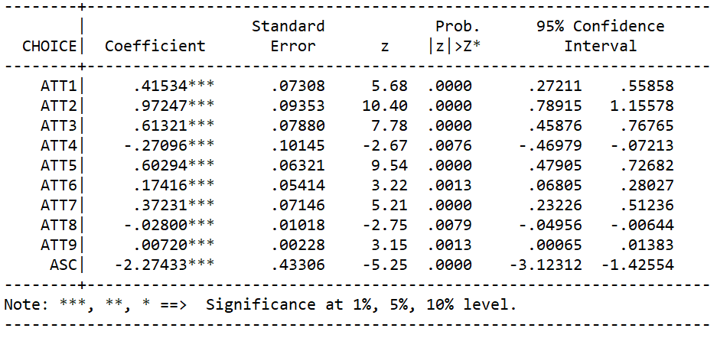
ATT 1 | Technical skill 1
ATT 2 | Technical skill 2
ATT 3 | Technical skill 3
ATT 4 | Non-technical skill 1
ATT 5 | Non-technical skill 2
ATT 6 | Hybrid course
ATT 7 | Feedback
ATT 8 | Duration
Academic’s Results
Page 19

Slide 22
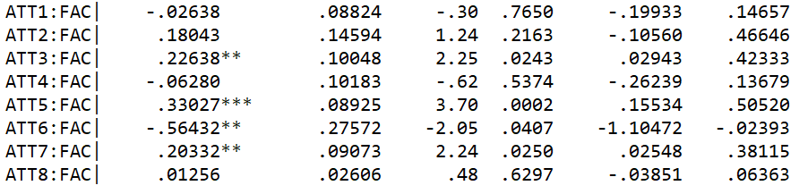
ATT 1 | Technical skill 1
ATT 2 | Technical skill 2
ATT 3 | Technical skill 3
ATT 4 | Non-technical skill 1
ATT 5 | Non-technical skill 2
ATT 6 | Hybrid course
ATT 7 | Feedback
ATT 8 | Duration
Academic’s Results
  QO1 Opinion on student’s training course
+ Opinion on student’s training course : More Tech Skills 3 required
        More N-Tech Skills 2 required
        Less e-learning courses required
        More hours for feedback required
Page 20

Slide 23
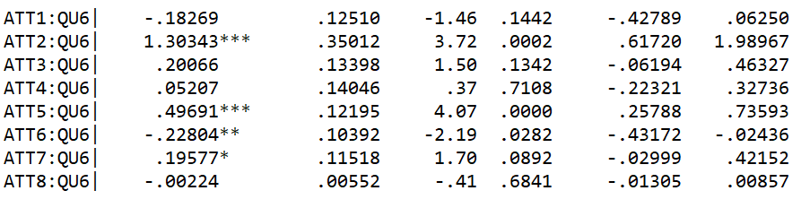
ATT 1 | Technical skill 1
ATT 2 | Technical skill 2
ATT 3 | Technical skill 3
ATT 4 | Non-technical skill 1
ATT 5 | Non-technical skill 2
ATT 6 | Hybrid course
ATT 7 | Feedback
ATT 8 | Duration
Academic’s Results
  Q6 Learning in Simulation
+ Learning in Simulation provided: More Tech Skills 2 required for students
More N-Tech Skills 2 required for students
        Less e-learning courses required for students
        Less feedback required for/from students
Page 21

Slide 24
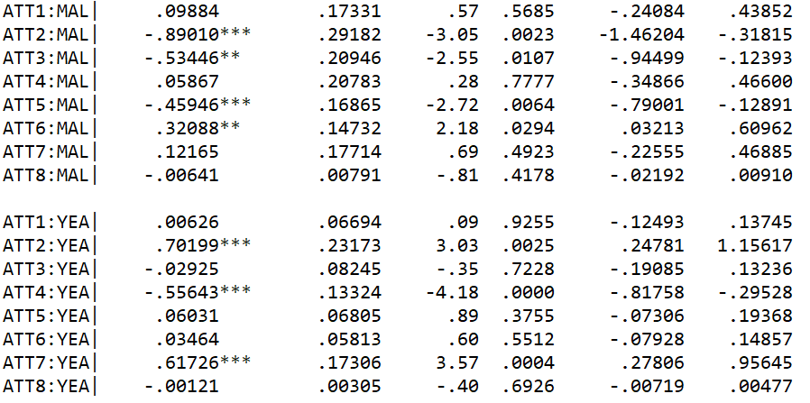
ATT 1 | Technical skill 1
ATT 2 | Technical skill 2
ATT 3 | Technical skill 3
ATT 4 | Non-technical skill 1
ATT 5 | Non-technical skill 2
ATT 6 | Hybrid course
ATT 7 | Feedback
ATT 8 | Duration
Academic’s Results
Male vs Fem: Less Tech Skills 2
        Less Tech Skills 3
        Less N-Tech Skills 2
        More e-learning courses
+ Year of enrolement: More Tech Skills 2
        Less N-Tech Skills 1
        More feedback
Page 22

Slide 25

Companies Survey
Numbers to reach 25-30 companies
20 companies included in our list
distribution of the questionnaire
google form (step 1) and/or emails/phone calls (step 2)
Timing
Intermediate check
<<<
Questionnaire preparation and pilot test with partner companies By end of March 2021 | Perform the survey with companies and collect the data April 2021 | Perform the survey with companies and collect the data May 2021 | Data analysis June - July 2021 | Needs Analysis and BoK Aug- Oct. 2021
Postponed
Page 23
Partner logo

Slide 26
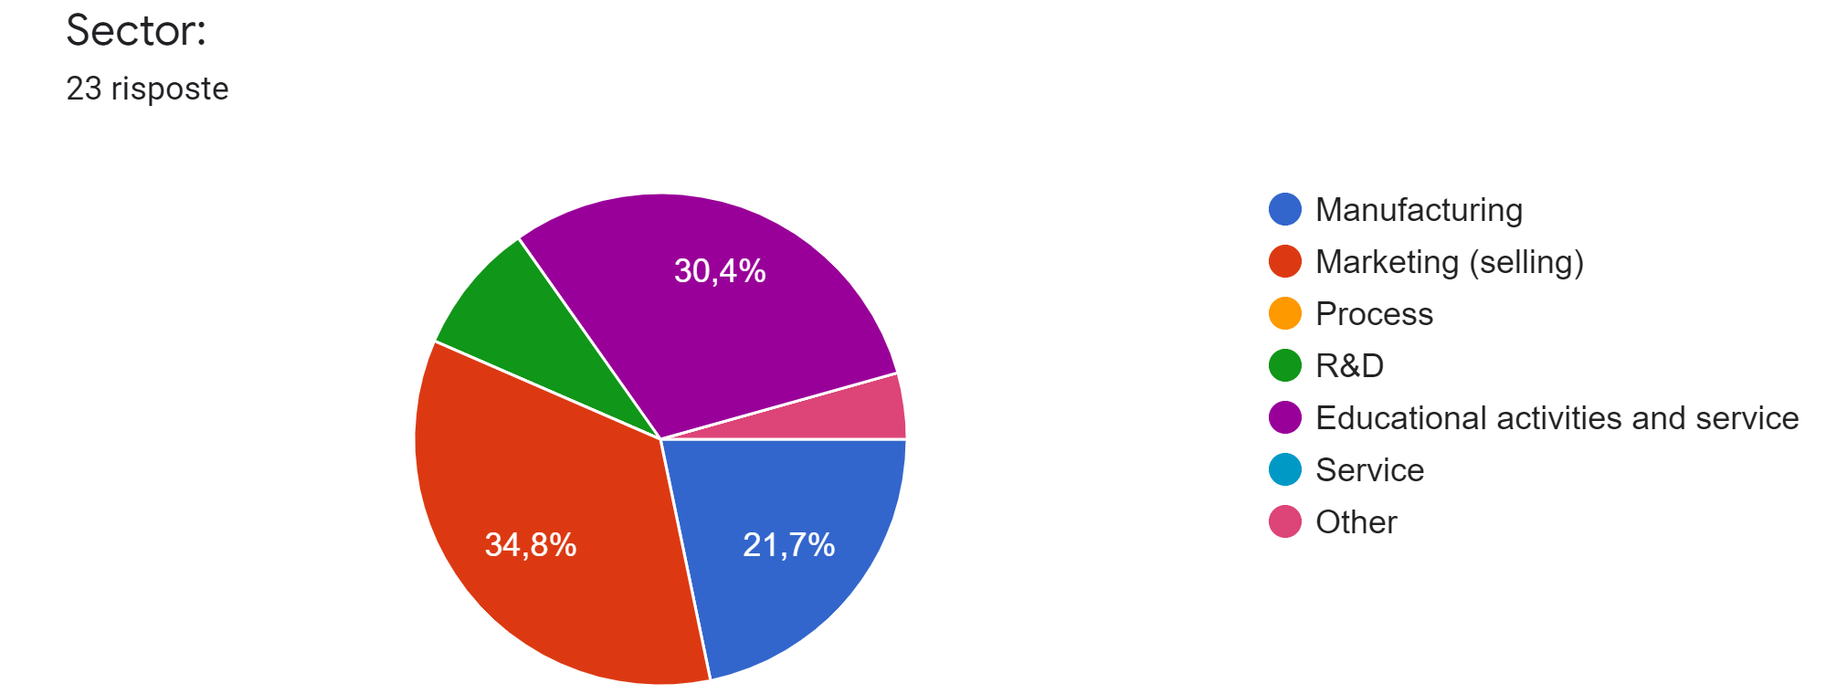
Companies Surveys
tot companies step 1= 23
tot companies step 2= 8
Page 24

Slide 27
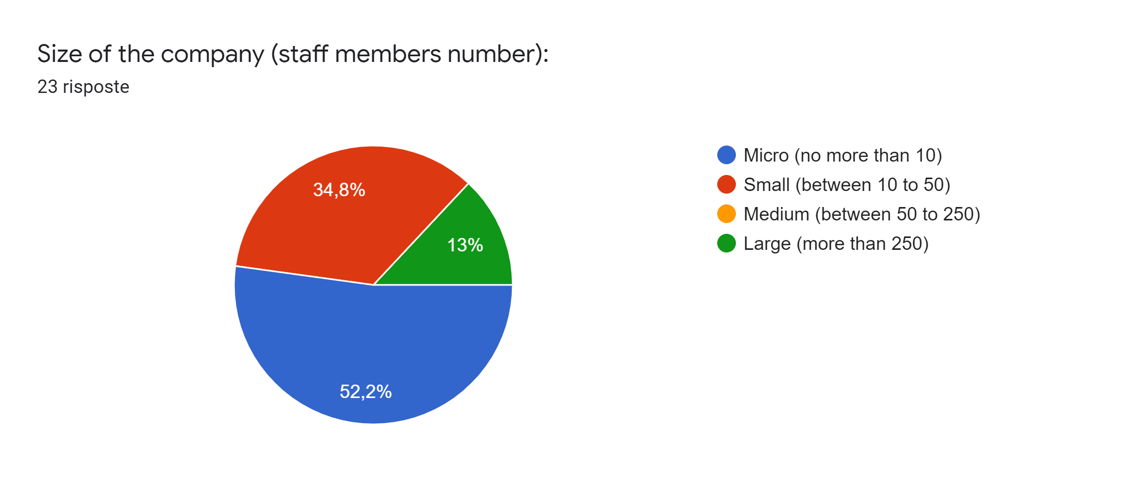
Companies Surveys
Page 25

Slide 28
Logical framework of Body of Knowledge
WP1
WP2
BoK
Method to merge WP1 and WP2 results (how good practices satisfy the needs emerged by WP2 results)
Structure of the courses
Target groups
Tools
Supply channels
Annexes (WP1 and WP2 reports)
Page 25

Slide 29

Thank you!
fedele.colantuono@unifg.it
francesco.barberio@unifg.it
gianluigi.depascale@unifg.it
ruggiero.sardaro@unifg.it

