Slide 1



WP2 Pilot test results
The European Commission's support for the production of this publication does not constitute an endorsement of the contents, which reflect the views only of the authors, and the Commission cannot be held responsible for any use which may be made of the information contained therein.

Slide 2

Academics/Experts
Feedback expected: 12
Feedback received: 11
Students
Feedback expected: 30
Feedback received: 17

Slide 3
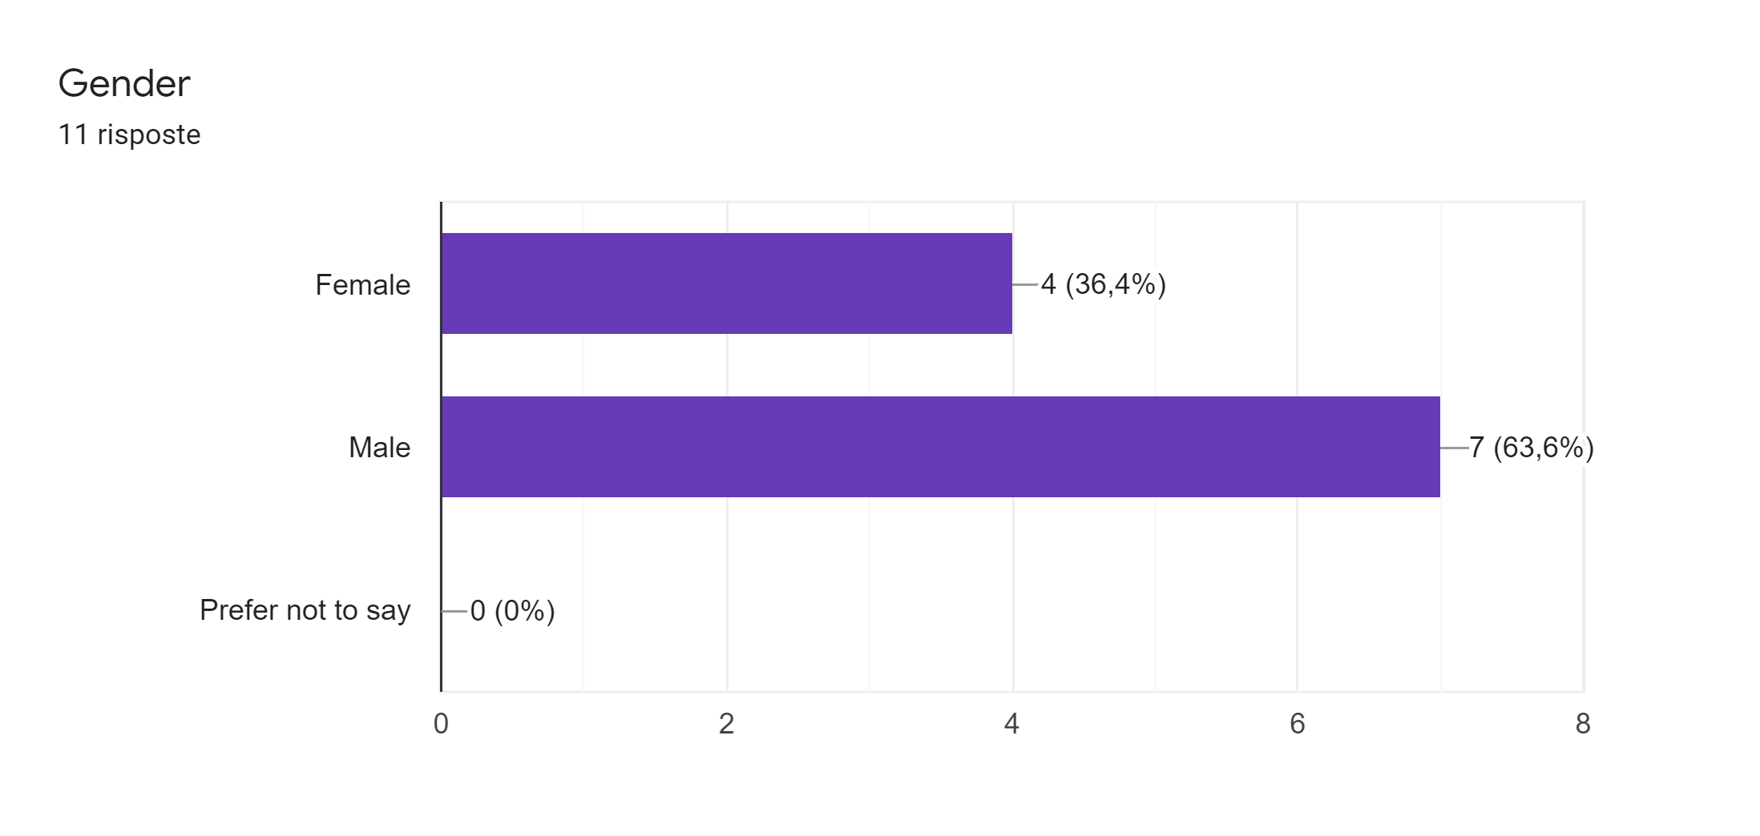
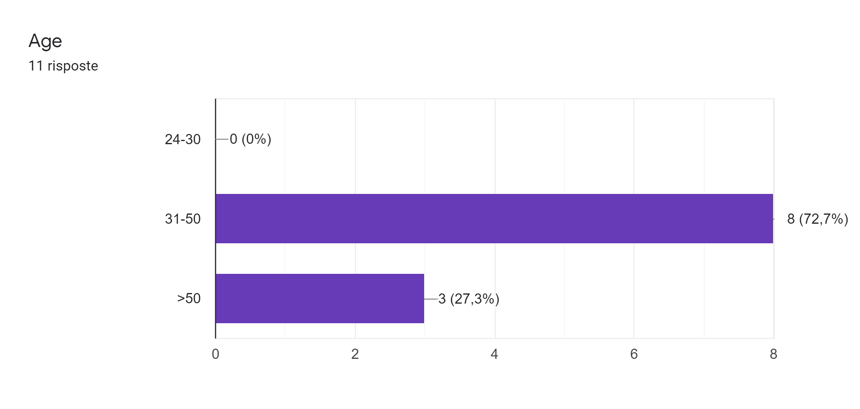
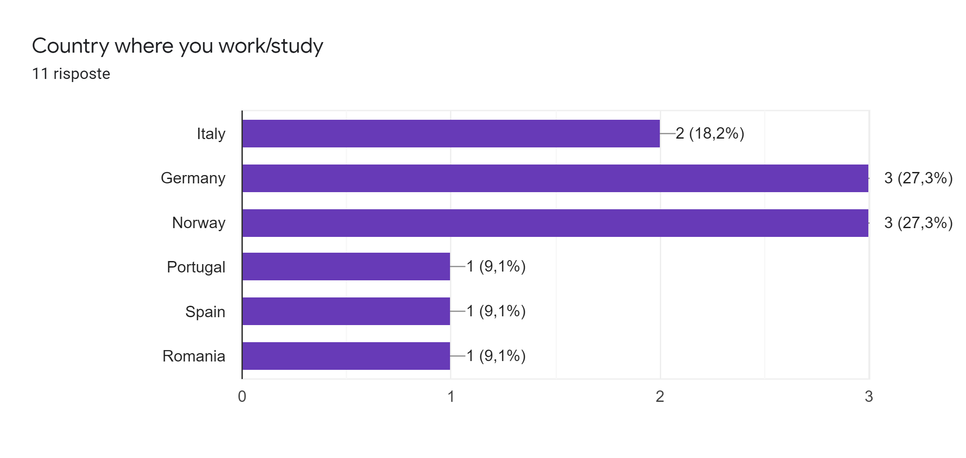

Academics/Experts - Demographic

Slide 4
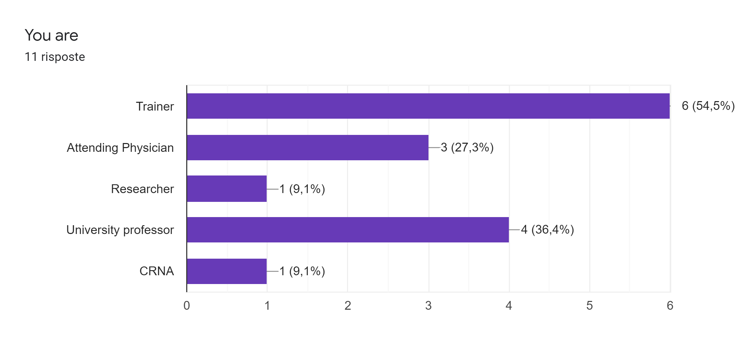
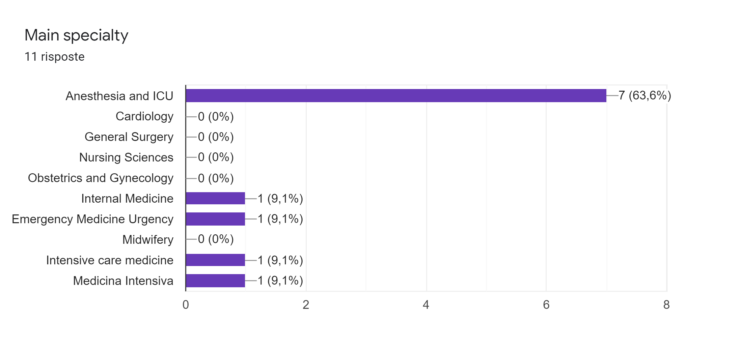
Academics/Experts - Demographic

Slide 5
Do you think that the questions in the survey are easy to understand? Could you tell us any unclear questions?
6 replied -> Everything Ok
1 suggested translation in native language
4 difficulty in reading part II
Sometimes it's difficult to understand whether the questions refers to your local university environment or are more general.
Academics/Experts

Slide 6
Would you prefer to receive this survey in English or in your native language?
Academics/Experts

Slide 7
How much time did you spent to complete this survey?
Time
Academics/Experts

Slide 8
Do you have any suggestion to provide us?
7 replied -> No
Mainly easy to understand. There were some inconsistencies in section 1, Q4g - suddenly, it says well prepared instead of confident. Also, the question about courses for CRM is rated on 5 point scale, whereas I would only see a yes or no answer possible, maybe a don't know. But I can't halfways agree that a course is taking place. Some questions are a bit difficult to understand, especially the first "I am confident about the skills acquired by the students during their university career and during emergency courses attended" - took me a while to understand I am being asked how much I believe students learn. Also, course selection - maybe the question should highlight if I need to answer as myself or imagine being a student.
It was a bit unclear if this was for med students, or nursing, or paramedic, or all? I am happy to answer as a test person, but do not work in the university now - however, I work in the hospital system and have develope an IPE teamwork day for med-nurse-paramedics, so my answers on the students abilities will be low considering. that being said
Having seen the students in simulations, and FY1 med students, and worked with newly graduated nurses, they have A LOT to learn about the emergency situations you asked us to review. Maybe a dilemma for the bachelor educators who themselves may not be very competent in teaching up-to-date emergency care.
Academics/Experts

Slide 9
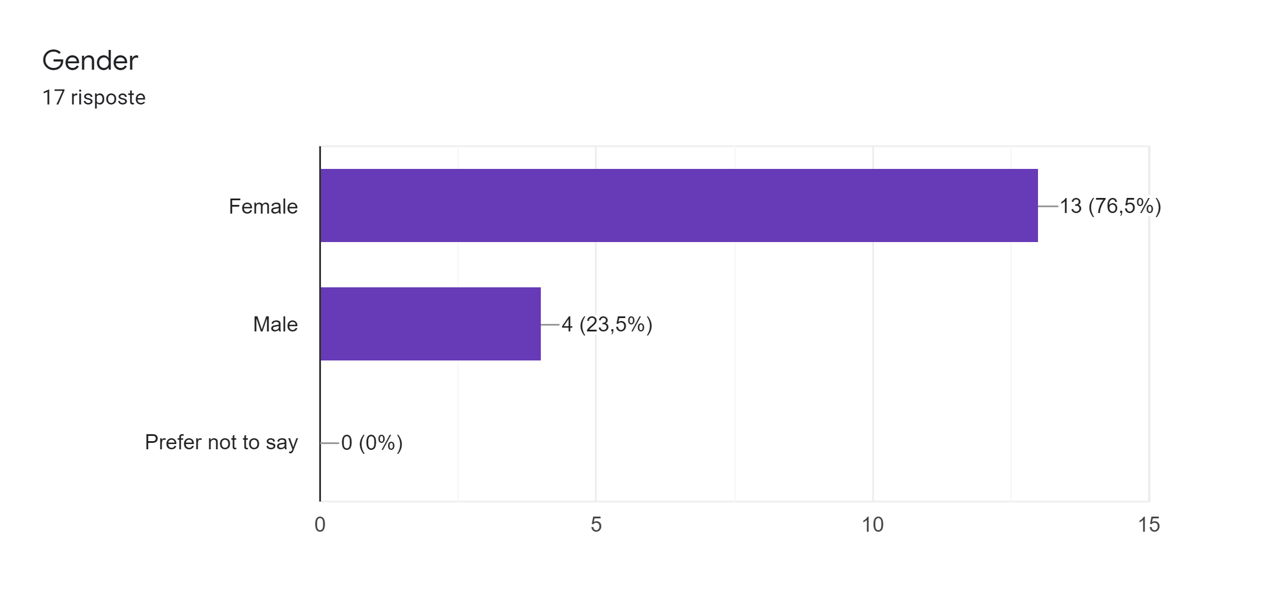
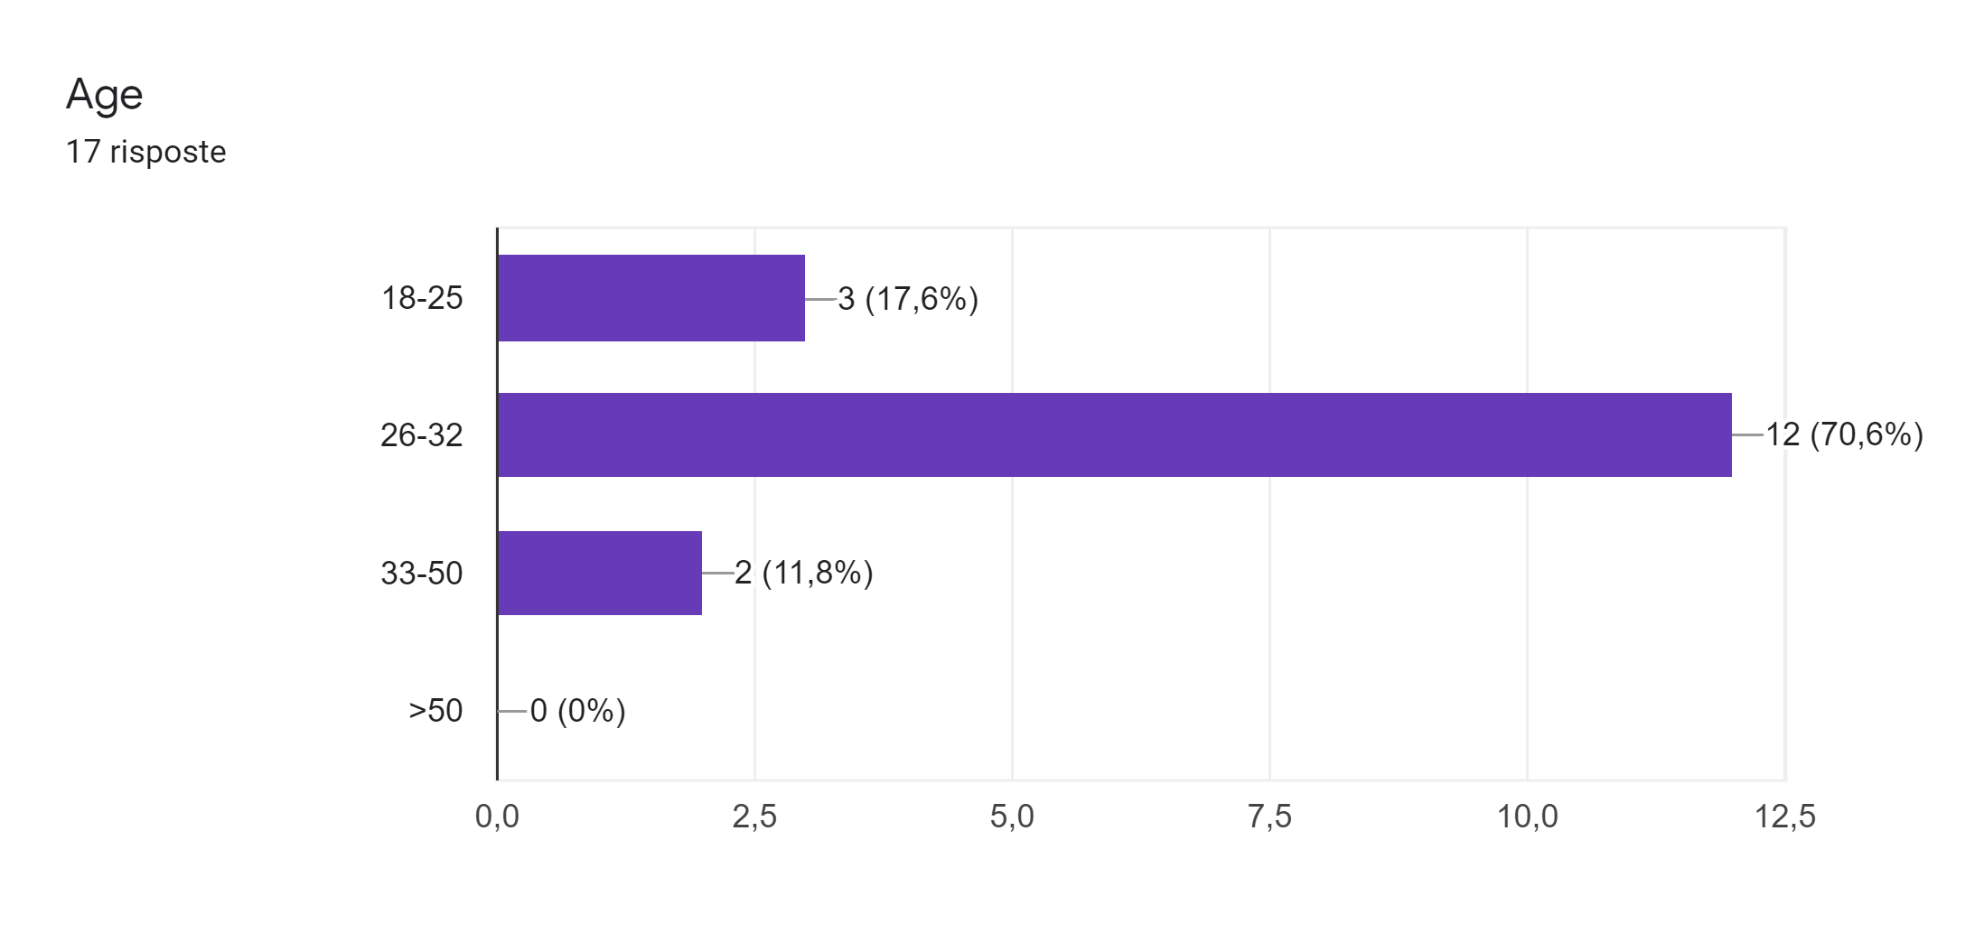
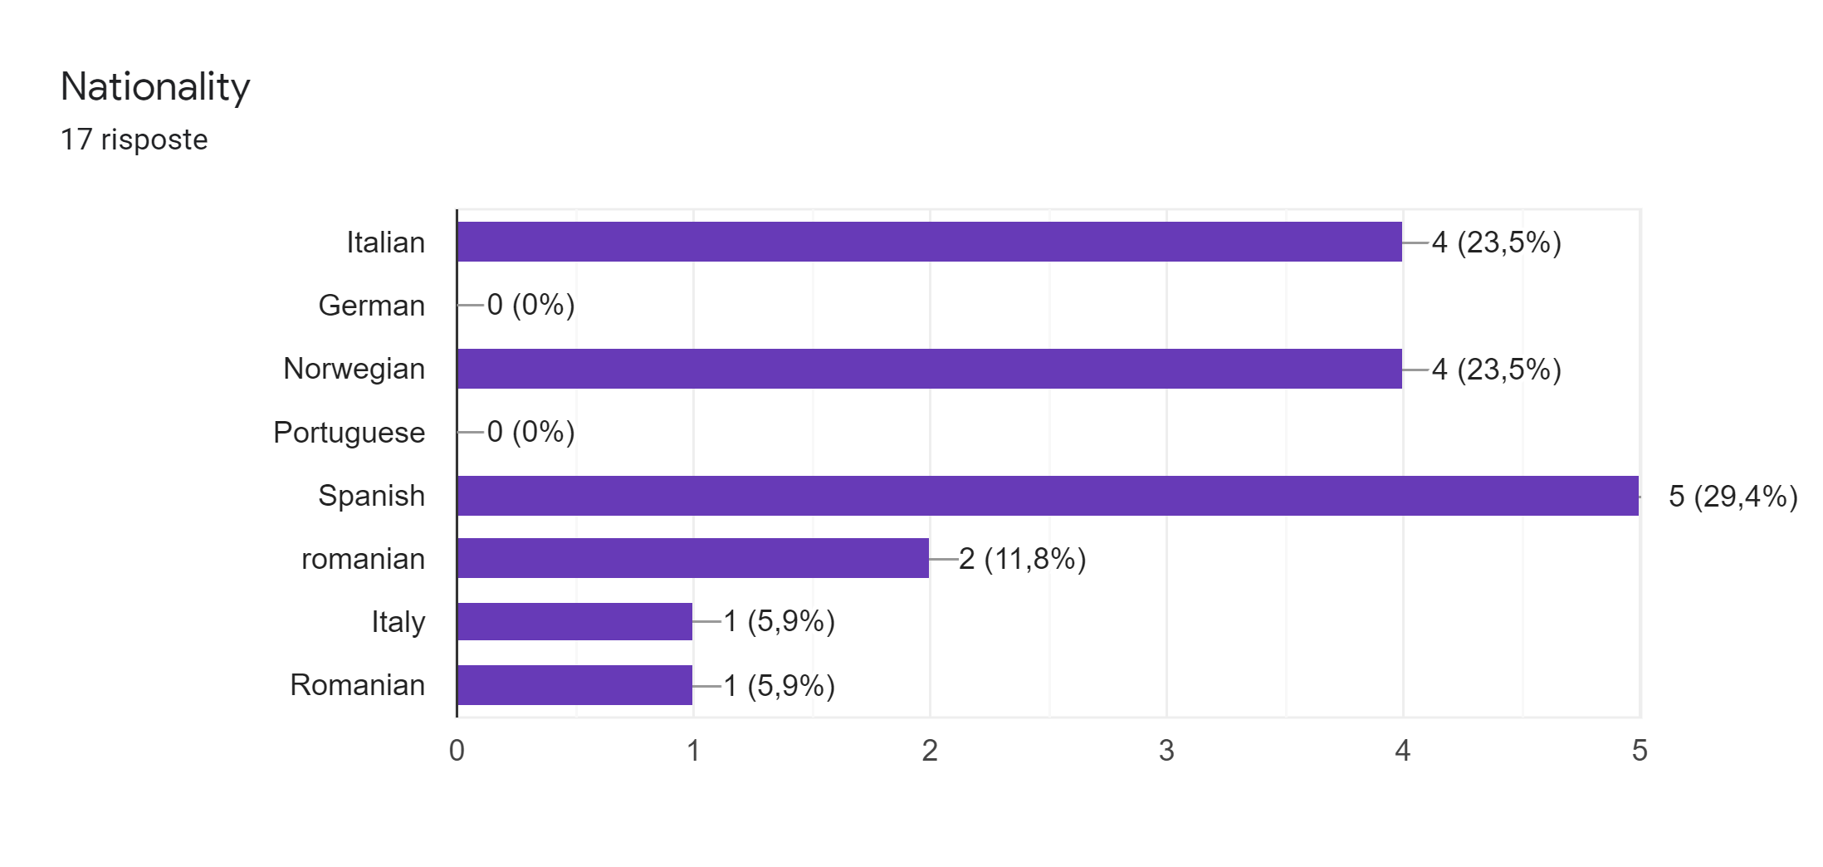
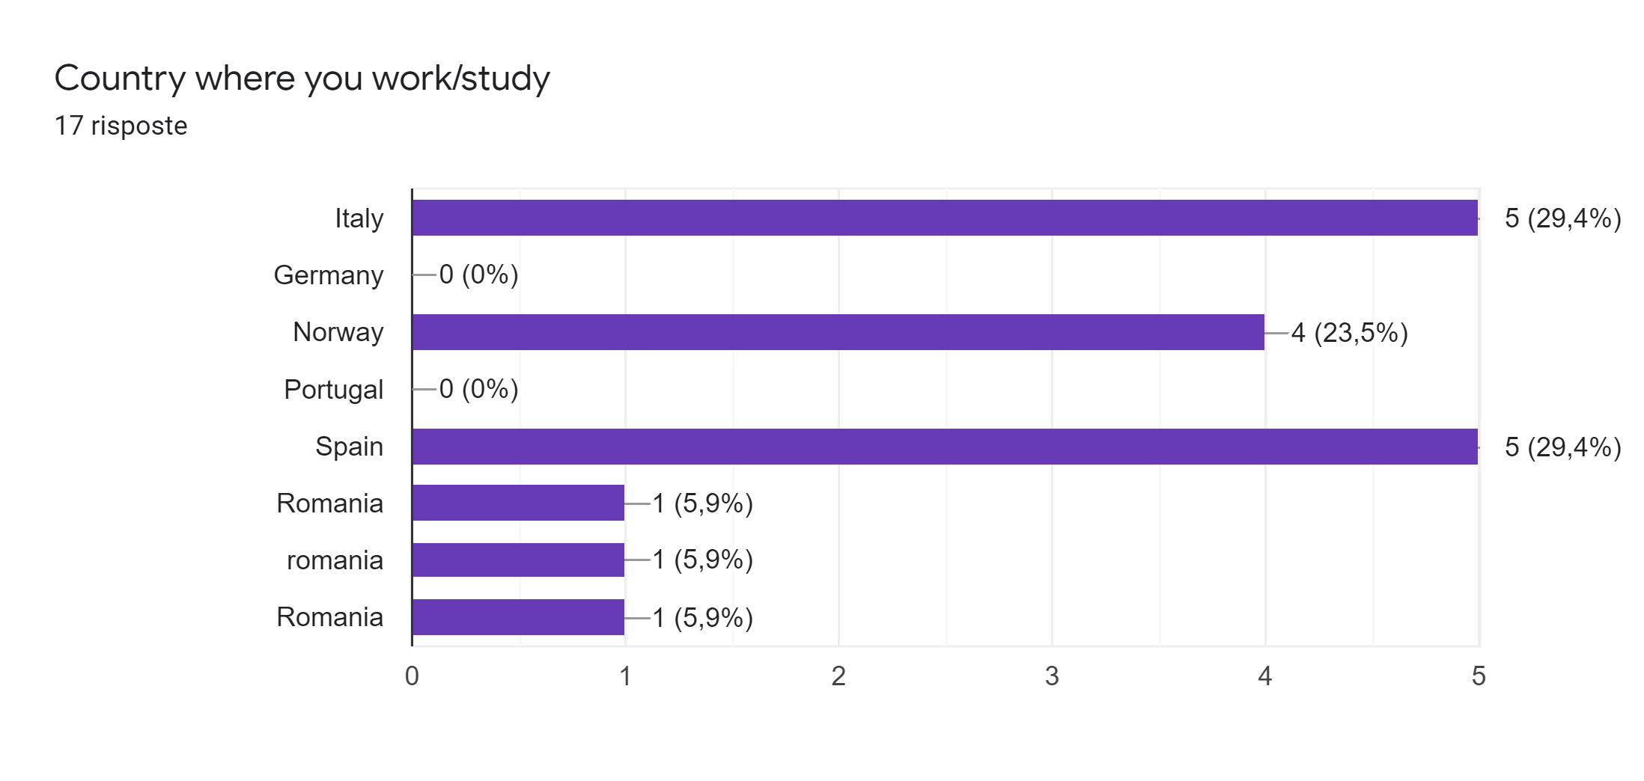
Students - Demographic

Slide 10
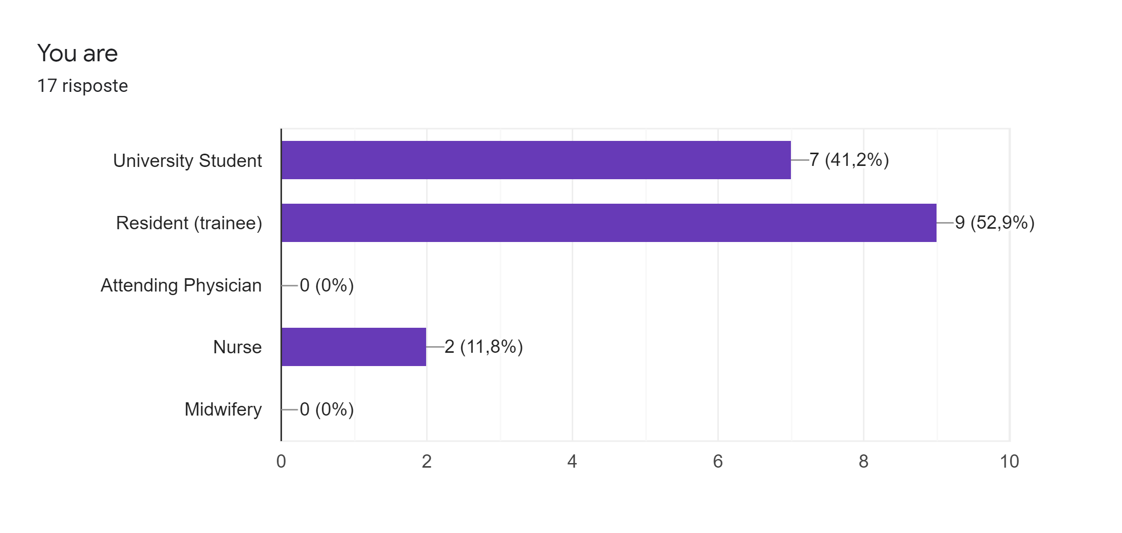
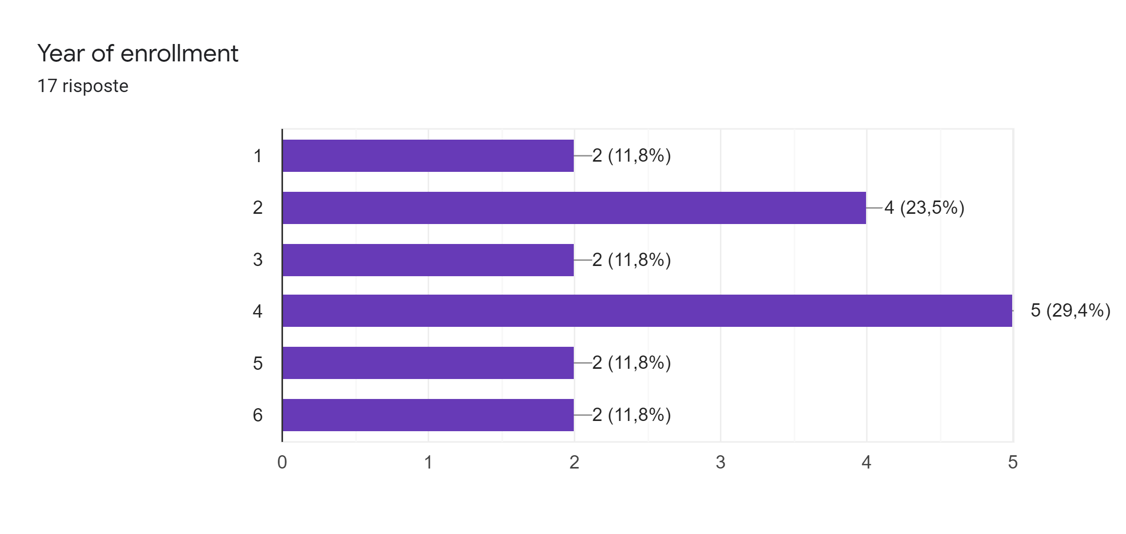
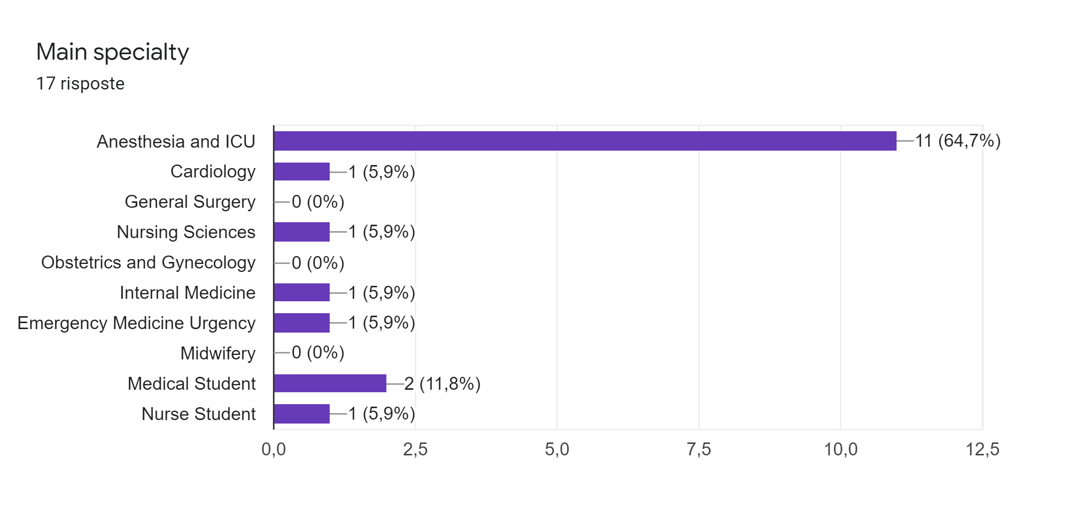
Students - Demographic

Slide 11
Do you think that the questions in the survey are easy to understand? Could you tell us any unclear questions?
14 replied -> Everything Ok
It is not clear if you area asking about med carrer at university or it includes trainee formation aswell
Be more spesific what the different treatment/disease are. Since english is not my main language, it takes more time for me to answer, because I have to google what it means in my language. If its explained after the questions, its easier to answer it correctly.
Students

Slide 12
Would you prefer to receive this survey in English or in your native language?
”Native language. But english is also ok, but i think you will get more correct answers if its in the partisipants native language”
Students

Slide 13
How much time did you spent to complete this survey?
Time
Students

Slide 14
Do you have any suggestion to provide us?
16 replied -> no
PART II is very hard to analize and compare between which one to choose.
Students

Slide 15
Decisions after WP2 meeting (11.03.2021)
Translation of the surveys in native languages
Students’ target group: try to disseminate above all to university students (med 5-6th years, nurse and midwifery 3rd year) or ask to postgraduate students to think about their emergency formation during their university career before their degree
Academics/Experts: ask them to refer their answers only to university students or first year postgraduates
Reduce the number of the choice sets of part II from 8 to 6 tables

Slide 16


Always include at the end of your questionnaires: final thanks, project disclaimer and logo!
Thank you for completing the survey!
Do you want to stay up to date on our analysis results and are you interested in our project?
Subscribe to our newsletter to join our SAFETY community and take a look at our latest news!
The European Commission's support for the production of this publication does not constitute an endorsement of the contents, which reflect the views only of the authors, and the Commission cannot be held responsible for any use which may be made of the information contained therein.

Slide 17
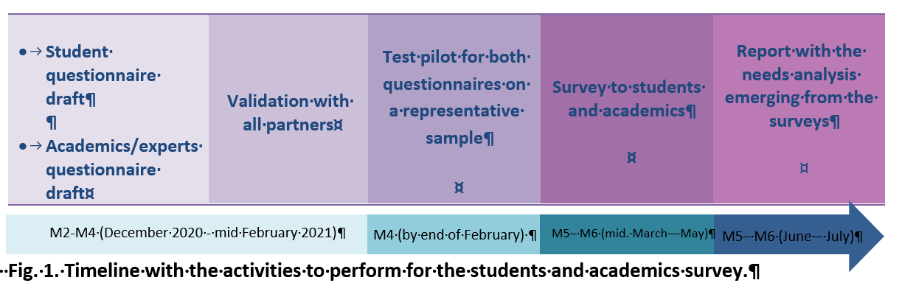
Data collection
At least 500 students from each country involved in the project
At least 100 academics from each country involved in the project
Start: 22-03-2021
End: 31-05-2021

Slide 18

Thank you!

