Slide 1

Virtual Project Meeting
Munich
20./21.12.2021
Dr. Marc Lazarovici, Dr. Katarina Grujic
LMU

Slide 2

Presentation WP3

Slide 3
Description &
Tasks
Link with the other WPs
Input: BoK (WP2)
Output: Evaluation model (EICD)
Output: Pathway and evaluated modules -> WP4

Slide 4
Description &
Tasks
WP3 will condense the BoK and create concrete training cases
BoK
  Evaluation of training cases
  Refinement of training cases
  Final evaluation

Slide 5
Description &
Tasks
Task 1 – Preparing course, defining pedagogical criteria
Analysis of BoK ☝
input pedagocical criteria received by questionnaire from partners 👍

Slide 6
Description &
Tasks
Task 2 – Design of e-learning course
Theoretical modules
Practical modules (25 cases in emergency medicine) 🡪 to be discussed

Slide 7
Description &
Tasks
Task 3 – Developing evaluation tools
Materials prepared by EICD
Results analysed by each university on their own cases

Slide 8
Description &
Tasks
Task 4 – Developing training material
As defined in Task 2 – practical creation of materials
Most probably Task 2 and 4 will be addressed together

Slide 9
Description &
Tasks
Task 5+6 – Evaluation and refinement of training material
🡪 Evaluation results will be analysed and training material revised

Slide 10
Results on Questionnaire

Slide 11
Results
MATERIALS NEEDED
EXPERIENCE IN MEDICAL EDUCATION
AIM
TESTING THE PILOT
COMPANIES SUPPORT

Slide 12
Materials for practical training
Full manikins for full scale simulation
Partial manikins for skills training (Airway Management trainer, venous & arterial, io access trainer, etc.)
SimCapture, vSIM, SonoSim (Laerdal), iSimulate
VR Trainer (Body Interact, Acadicus, Immersive Interactive, OMS, SimX)
🡪 TOPIC OF EUROPE CAFÉ

Slide 13
Medical Education
Pedagogical concepts used by universities:
Blended Learning
Problem based Learning
Team based Learning
One-on-One and small groups Teaching
Simulation
Recommendation for online course
Interactive
Active participation
Flipped classroom
🡪 Topic for open discussion in workshop Tuesday

Slide 14
Pilot Testing
Testing on residents/students in simulation center (UniFg)
Pilot course with students in nursing and paramedicine (UiS)
Testing and recording (EICD)
All-over support and product access (Body Interact)

Slide 15
Proposal
Architecture e-learning Course

Slide 16
Blended Learning Concept
THEORY BLOCK
INTERACTIVE WORKSTUDENTS PEER-LEARNING, PROBLEM-BASED LEARNING, ONE- MINUTE-PAPER, OPTIONAL PODCASTS ON CLINICAL CASES, GUIDELINES, ETC)
SKILLS TRAINING
Developing problem solving skills,
Leadership and Teamwork
Introduction to SIM
ONLINE SUPPORT AND SKILLS-VIDEOS
INDIVIDUAL TEACHING (FACE-TO-FACE)
SIMULATION TRAINING
FULL SCALE SIMULATOR, VR-REALITY, TRAINING IN SIMULATED ENVIRONMENT (VR-HEADSET, LAPTOP)
APPLICATION SHARING (E-MAIL, CHAT, SOCIAL-MEDIA GROUPS, NEWSLETTER, PODCASTS)

Slide 17
Proposal
Duration 1 Semester
Preparation of subjects for theoretical block (online format)
Preparation of skills training on defined skills
Construction of 25 practical Courses (online format)
🡪 RESULTS FROM EUROPE CAFÉ (afternoon)

Slide 18
Virtual Project Meeting
Munich
20./21.12.2021
Dr. Marc Lazarovici, Dr. Katarina Grujic
LMU

Slide 19
25 Online Courses

Slide 20






Proposal
Interdisciplinary
Trauma
Pediatrics
Shock
Neurology
Cardiopulmonary

Slide 21
Proposal
Cardiopulmonary
Trauma
Pediatrics
Neurology
Shock
Interdisciplinary
ACS
Tachyarrhythmia
Bradyarrythmia
Hypertension
COPD/Asthma
v
Polytrauma
Traumatic brain injury
Abdominal Trauma
Musculoskeletal Trauma
Childbirth
Infant Dyspnea
Stroke
Intracranial Hemorrhage
Epilepsy
Psychosis
Hypoglycemia
Hemorrhage
Sepsis
Anaphylaxis
CPR
Difficult Airway
Dyspnea
Thermal injury
Multimorbidity
Palliative Care
Emergency in pregnancy

Slide 22
Modified Proposal after Conversation
Cardiopulmonary
Trauma
Neurology
Shock
Special Circumstances
Hypovolemic shock, e.g. Hemorrhagic shock
Distributive shock - Sepsis, Anaphylaxis
Cardiogenic shock- CPR
Obstructive shock, e.g. Tension pneumothorax
Childbirth
Infant Dyspnea
Emergency in pregnancy
Thermal injury
Toxicological emergencies
Multimorbidity and Palliative Care
ACS
Tachyarrhythmia
Bradyarrythmia
Hypertension/ Hypertensive crisis
Respiratory failure and Airway Management
Polytrauma
Traumatic brain injury
Abdominal Trauma
Musculoskeletal Trauma
Stroke
Intracranial Hemorrhage
Epilepsy
Psychosis
Hypoglycemia
TEAMWORK, DECISION MAKING, CRM

Slide 23
Conclusions about scenarios after conversation
Adaptive e-learning, based on profession, edcation level, etc.
Educator/facilitator should be able to vary the utilisation of the scenarios based on
  Target group
  Learner level
  Learning goal (e.g. more on the skill side, more decision making, etc)
  Available resources (Manikins, Software, Task trainer, etc)
  Usage on manikin or in computer-based VR
Concept of Scenario overlapping through all target groups, eg. ACS treated by EMS, admitted to hospital and taking over by nurses and doctors

Slide 24
Question regarding scenarios after conversation
Facilitated or automatic?
Who has which scenarios in some stages of preparation?
LMU to send a table for partners to fill out wih questions regarding the scenarios.

Slide 25
Pedagogical Criteria
e-Learning Course

Slide 26
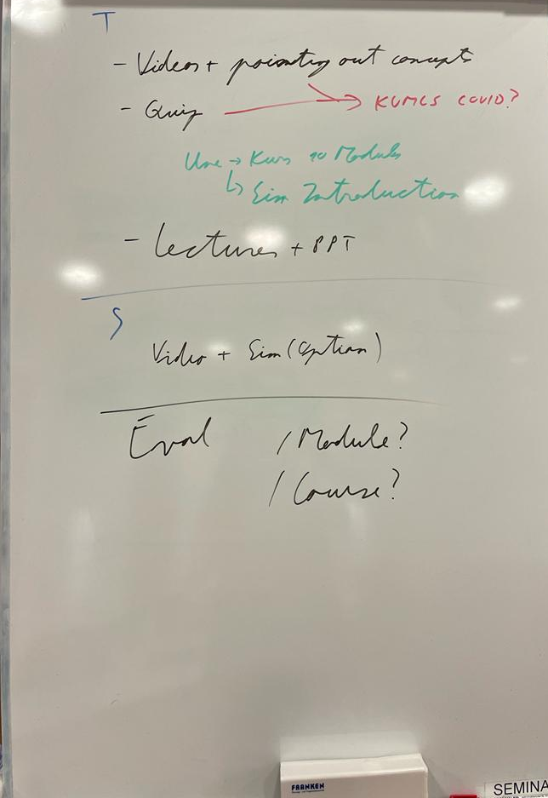
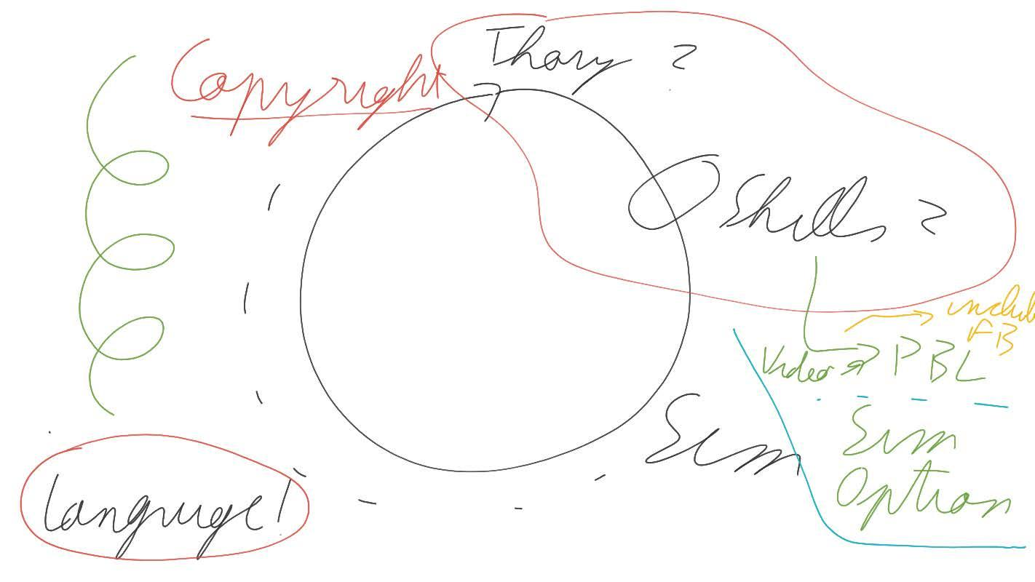
Pedagogical Criteria
Discussion with partners

Slide 27
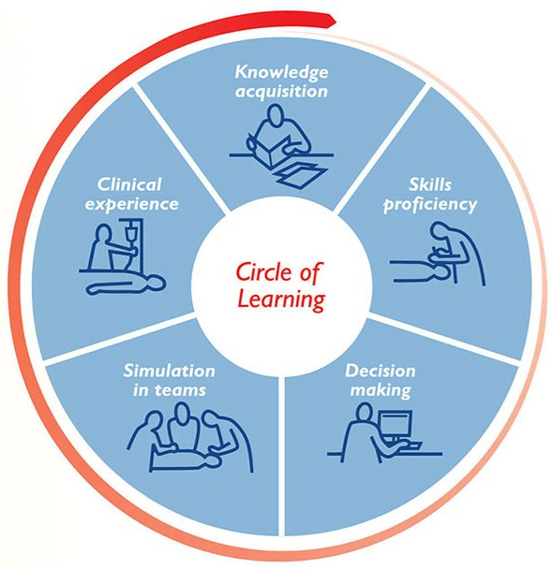
Pedagogical criteria
Learning Circle - Learning as continous process
  In time as a spiral, as more knowledge is acquired
Theoretical knowledge
  Flipped Classroom
  On-demand learning course (delivered by theory content largely coordinated with scenarios)
  Interactive Learning, Problem-based Learning, optional Podcast on Guidelines or latest news
  Videos, also pointing out relevant points
  Include quizzes
  Lectures based on powerpoint – CAVE copyright!
  Maybe examples from Une/UIS to whole group

Slide 28
Pedagogical criteria
Skills
  Videos (procedural learning), include feedback in video
  Simulation (motor learning)
  Defined skills training on manikins depending on target group
Make videos and scenarios primarily in english, but also available also in local languages
  Possibly subtitles in video

Slide 29
Technical Criteria
e-Learning Course

Slide 30
Technical Criteria
Discussion with partners
Probably Google Course as platform
  Check of reachability from hospital network necessary
Powerpoint as basis for presentations ok for all partners
  Template to be designed by LMU
Videos in any format, disclaimer and logo at beginning and end, landscape
Information on disclaimer, logo and other EU requirements to be sent by Antonio to LMU

Slide 31
WP3 Work Plan, Tasks, Preparation, Deadlines

Slide 32
WP3
Coordination with EICD (Evaluation of WP3)-Periodic meeting
Introduction on JIRA

Slide 33
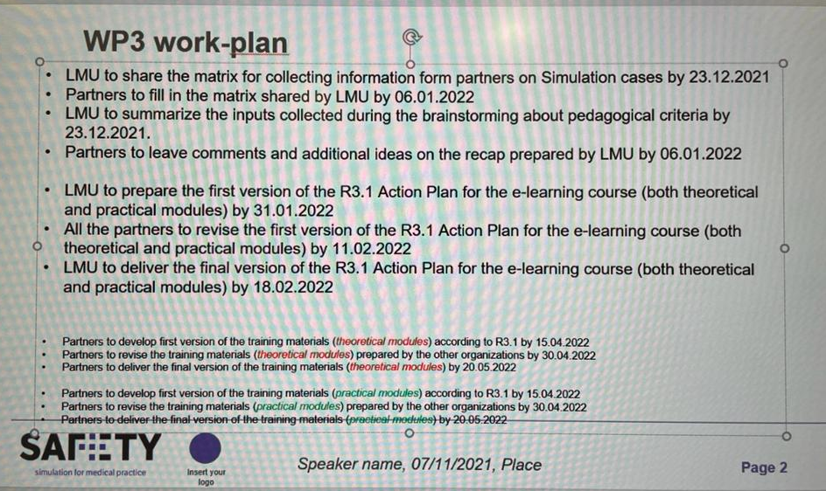
WP3

Slide 34
Thank you!

