Slide 1


SAFETY project meeting
Recap on the fundamental elements f
rom WP2 needs analysis and BoK
[starting point for the creation of the course]
…………………………….
Fedele Colantuono, UniFg

Slide 2
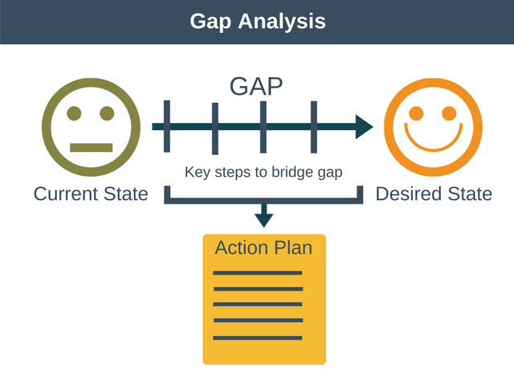
WP1 desk research report
+
WP2 needs analysis report
=
Final output with a list of knowledge, competencies and skills to meet the needs of the target groups.
Body of Knowldege

Slide 3
From WP1 desk research
1) the number of courses, the type, the organization and the providers are different according to the European countries screened;
2) few courses are provided for students but many specific courses for the various emergency branches (cardio, anesthesia, pediatrics, etc.)
3) few courses based on Non Tecnical Skills and CRM are provided
- Good Practice: related to different scenarios, prebriefing and debriefing, evaluation and improvement
From WP1: review on best team composition
No studies in the literature on Optimal Team Composition on training in simulation (only concern scenarios of real experiences)

Slide 4

WP2: Students and Academics Surveys
Language Version | Students | Academics
English | 9 | 2
German | 255 | 17
Italian | 312 | 92
Norwegian | 24 | 14
Portuguese | 6 | 1
Romanian | 534 | 52
Spanish | 324 | 110
TOTAL | 1464 | 288
Page 03

Slide 5
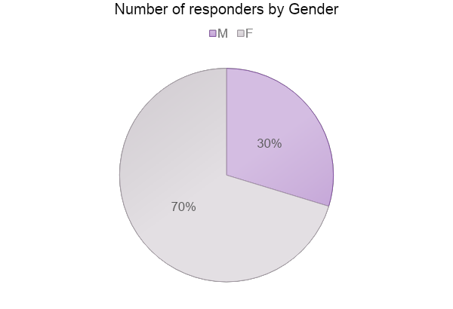
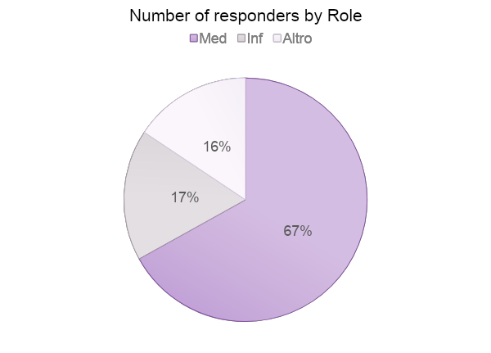
WP2: Students Survey
School Med. | 980
School Nurse | 255
Others | 229
M | 435
F | 1029
Page 05

Slide 6
WP2 students need analysis main findings
for training increase there is a greater demand for courses in e-learning mode, a greater demand for feedback and longer courses
for university educational offer increases, there is a greater demand for courses based on emergency management and team management; there is less demand for courses conducted in e-learning mode and of a shorter duration.
as training on team work increases, there is a greater demand for courses in e-learning mode; there is less demand for courses based on emergency management, from a procedural and team management point of view.
as the ability to manage Health Emergencies increases, there is a greater demand for courses conducted in e-learning mode and over several hours; the lower the demand for courses based on the learning of Technical Skills
As the acquisition of Technical Skills increases, there is a lower demand for courses based on the acquisition of the Technical Skills themselves; On the other hand, there is a greater demand for courses based on team working of a longer duration.
distinction with respect to geographic distribution. Students from Northern European countries (Germany and Norway) require courses more based on learning procedural management and emergency team management, in which there is active feedback, compared to Southern European countries (Italy, Spain, Romania)
Students enrolled in nursing studies require courses that are less based on learning how to manage emergencies from a procedural and team management point of view than students enrolled in degree courses in Medicine and Surgery;
whereas, paramedics and doctors in specialist training require courses based more on these attributes than the students of Medicine and Surgery

Slide 7
The BoK structure
an introductory section presenting the gap analysis according to the Desk researches (WP1) and the training needs (WP2): qualitative and quantitative gatherings and good practices.
a section to detail the knowledge, competencies and
skills to be developed in order to fill the gaps presented
a section including a series of solutions to adopted into the new courses
definition of target groups
training tools
training delivery channels and media
Annexes (WP1 and WP2 reports)

Slide 8
next step…
meeting with WP1 and WP2 leader, supported by UIS to discuss and compare reports results (by mid Jan. 2022)
meeting with all academics partners to define and revise the BoK (by end Jan. 2022)
meeting all partners and first insights of courses structure (by mid February 2022)
….any further proposal?

Slide 9

Thank you!

