Slide 1

Guidelines for
Administrative and
Financial Management
SAFETY
Simulation Approach For Education and Training in emergencY
Alessandro Guadagni - ValueDo
The European Commission support for the production of this publication does not constitute endorsement of the contents which reflects the views only of the authors, and the Commission cannot be held responsible for any use which may be made of the information contained therein.

Slide 2
Contents
Financial procedures
Duration of the Project
Total EU contribution and Approved Budget
Pre-Financing
Reporting Periods
Technical and financial reporting (Interim)
Final Report

Slide 3
Duration of the project
36 months
November, 1st 2020
October 31st 2023

Slide 4

Total EU contribution
EUR 932.779,00
Corresponding to 100% of total eligible costs

Slide 5
Approved Budget
Partner name | Country | Project Implementation Support | TOTAL GRANT
Università degli Studi di Foggia (UNIFG) | Italy | 187.552,00 | 187.552,00
University Clinic Hospital of Barcelona (HUBc) | Spain | 93.851,00 | 93.851,00
“Prof Dr CC Iliescu” Emergency Institute for Cardiovascular Diseases (EICD) | Romania | 53.976,00 | 53.976,00
Ludwig-Maximilians University of Munich (LMU) | Germany | 141.600,00 | 141.600,00
University of Stavanger (UiS) | Norway | 148.679,00 | 148.679,00
ValueDo s.r.l. (Value) | Italy | 96.916,00 | 96.916,00
Infotech (INFO) | Italy | 64.349,00 | 64.349,00
Laerdal Italia s.r.l. (LAE) | Italy | 53.386,00 | 53.386,00
Alpha Medical Concepts (ACM) | Austria | 59.427,00 | 59.427,00
Take the Wind (TW) | Portugal | 33.043,00 | 33.043,00
TOTAL |  | 932.779,00 | 932.779,00

Slide 6
Pre-financing
The Commission grants to the Co-ordinator:
40% within 30 days from the entry into force of the Grant Agreement
40% after the approval of the Technical Report on Progress and if the 70% of the 1° pre-financing has been spent
20% as a balance after the presentation of the final report (within 60 days from the receipt of the documents)
(Art. I.5 – Grant Agreement)

Slide 7
Reporting periods
Technical Report on Progress
the report will cover the first 18 months of the project
To be delivered by 30.06.2022
Final Report
the report will cover the last 18 months of the project
within 60 days from the end of the project (expected by 31.12.2023)
(Art. I.4 – Grant Agreement)

Slide 8
Progress Report
The coordinator must submit a request for second pre-financing payment within 60 calendar days following the end of the first reporting period (April 2022).
The request must be accompanied by the following documents:
a progress report on the implementation of the action (“technical report on progress”);
    An evaluation of the results of the project compared to the initial objectives;
    Details on the development, progress and achievements of the project;
    A summary of the main results
a statement on the amount of the previous pre-financing instalment used to cover costs of the action (“statement on the use of the previous pre-financing instalment”).
The second pre-financment shall be paid to the coordinator within 60 days from the approval of the Interim Report. To receive the full amount (40% of the total bugdet), the partners must demonstrate to have spent at least the 70% of the first payment.
(Art.I.4 – Grant Agreement)

Slide 9
Final Report
FINAL FINANCIAL STATEMENT
A Final Technical report including all the information needed to justify the contribution requested on the basis of unit costs
A Final Financial statement including a consolidated statement and a breakdown of the amounts claimed by each beneficiary
A summary financial statement including the financial statements already submitted previously and indicating the revenue generated by the action
Declaration signed by the Legal Representative of the Lead Partner certifying that the information provided for calculating the final grant is full, reliable and true and can be substantiated by relevant supporting documents.
  This is why the Lead Partner must receive all the timesheets and the supporting document in original certified copies (see slide 30)
All the project Results declared as Public in the Project description must be uploaded in the Erasmus+ dissemination platform before report submission

Slide 10
Final Report
The balance shall be paid to the coordinator within 60 days from the approval of the Final Report.
Tha Agency determines the amount due as the balance by deducting the total amount of pre-financing payments already made from the final amount reported for the project. The grant approved for the project represent the maximum amount that can be paid as balance.

Slide 11
Contents
Reporting procedures
Unit Costs system
Eligible staff and reporting
Supporting documentation for staff
Calculation of the final EU grant

Slide 12
Rules of the eligibility of costs
New financing system, based on Unit Costs, but rules of the eligibility of costs remain the same
Costs should be:
Foreseen in the budget, necessary and directly linked to the performance of the project
Generated during the life time of the project and reasonable and justified
Recorded in the accounts in accordance with the applicable accounting principles & requirements of tax and social legislation
Be identifiable and verifiable and allow reconciliation between accounts and supporting documents
Realized during the project lifetime (01.11.2020 – 31.10.2023)

Slide 13
UNIT COSTS – PROJECT IMPLEMENTATION AND SUPPORT (STAFF COSTS)
The "unit costs" system is a simplified form of determining the amount of the grant; by its nature, such simplified forms of grants are contributions to the main costs of a project which are not a reimbursement of the real expenditures linked to specific activities in the project.
The EU contribution, calculated through the unit cost, could not fully cover all expenses. It is for the beneficiary to ensure that all activities will take place as planned.
This unit cost contribution per day worked co-finances:
All activities directly linked to the implementation of the project :
project management, project meetings, production of project results, studies, dissemination, participation in events, conferences, travel, etc
All costs linked to these activities:
Staff cost, travel and subsistence, subcontracting, equipment and overhead costs.

Slide 14
Unit Costs System
The resulting EU contribution to co-finance all activities/costs of the project is divided in two different headings:
  Project implementation support
  Learning Mobility activities
  not included in the SAFETY budget

Slide 15
Unit Costs System
Principles
The EU grant for the “project implementation support” for Knowledge Alliances is based on the following points:
  A unit cost contribution (16 separate unit staff costs - 4 groups of countries on the basis of their respective Gross Domestic Product per capita, and to each group is allocated a unit staff cost for the 4 distinct personnel categories);
  For each work package and related activities, the partners estimated the number of staff days needed per category;
  The number of staff days shall then be multiplied by the unit costs indicated in the E+ Programme Guide (next slide)
  The budget for each partner was calculated as it follows
  Staff working days x unit contribution =
  EU Grant (contribution for implementing the project)

Slide 16
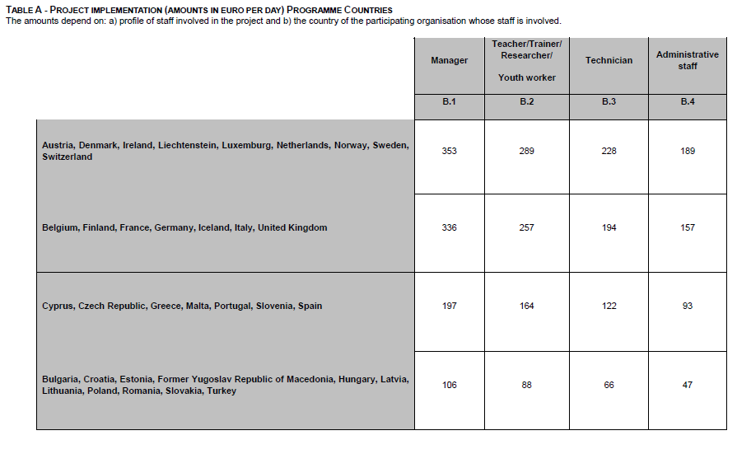
UNIT COSTS – PROJECT IMPLEMENTATION AND SUPPORT (STAFF COSTS)

Slide 17
Staff categories
For defining to which staff category one worker belongs to, it is important to check what it is stated in his/her employement contract (tasks/roles) and the reference to the ISCO-88 classification.
The role that the worker has in the project is not relevant.
Staff Category 1: Manager
  In the case of Universities, cat.1 is represented by Academics with administrative/decisions roles (such as Deans, vice-Deans, Heads of Department, et similar) or high administrative employees, with high administrative responsibilities
  Staff Category 2: Teacher/Trainer/Researcher
    In the case of Universities, cat. 2 is represented by all the professors, researchers, Fellows, students with a grant paid by the project, PhD students dedicated to the project, etc.)
  Staff Category 3: Technicians – Technical staff
  Staff Category 4: Administrative workers
      Full information on ISCO-88 can be found here (Part II and Part III)

Slide 18

Staff categories

Slide 19
Example
STAFF COSTS REPORTED IN THE FINANCIAL STATEMENTS
EXPENSES COVERED BY THE CLAIMED STAFF COSTS
Staff Category | Number of days | Unit cost | Total
Mananger (IT) | 10,00 | 336,00 | 3.360,00
Attendance project Meeting | 650,00
Leaflets printing expenses | 300,00
KoM organization expenses | 436,00
Staff recruited for the project | 1.000,00
Etc…etc… | ……

Slide 20
How to report costs in the unit costs system
The reporting will follow the same criteria as the application (number of working days per staff category) and you will be asked to complete a similar table as the one for the application.
The information that you will need are the real number of days of staff work (based on the time sheets) and the category of the staff involved (manager, researcher, administrative, secretary, based on the employment contract).
This information will allow calculating the final grant that cannot exceed the amount of the EU grant in the contract. The total incurred costs are not required because the system gives the reasonable assurance that the grant is only a contribution to those costs.
There is no need to report the own funding, but only the EU grant (based on unit costs)

Slide 21
Eligible staff and reporting
What is intended by "staff"
A person involved in the project having a legal, financial relation with a member of the Consortium.
Staff is a person with employment contract or equivalent appointing act = case by case approach
General principles
Subordination link (e.g. no trainees, no external experts, no free-lancers 🡪 there must be a pay-slip);
Related to permanent, temporary, and interim staff employed by partner organisations;
Traceable in the accountancy;
Working time declared and properly justified by an internal time recording system 🡪 this is Partners’ responsibility;
Formally assigned to the project implementation activities (suggested; internal document);
listed in the “Staff members list” provided by ValueDo.

Slide 22
Focus 1: «Not eligible staff»
Working staff days of Learners/Trainees, volunteers and persons working through subcontracting (e.g. freelancers, self-employed persons, persons registered as sole traders) cannot be considered as eligible staff days and are not accepted as number of units, consumed or produced to be claimed for the calculation of the grant based on unit costs,
except if
the national legislations of the partners involved in the project consider these staff as "assimilated" to a permanent, temporary or interim staff.
In this case, additional supporting documents may be requested in order to explain the national context.
General rule: if there is not a pay-slip the expenditures for the staff member are not eligible

Slide 23
Focus 2: «SME Owners»
In case the staff is the owner of a company, costs related to the work of business owners can be assimilated to staff costs, even in the absence of employment contract, provided that certain conditions are met:
  The amounts are not drawn by the profit of the company, but there is a monthly pay-slip;
  there is a statutory link between the business owner and the company;
  the expense in favor of the business owner is traceable in the accounting system of the company;
  the time declared is properly recorded and justified, e.g. through am internal timesheet system.
  If the company owner does not pay himself/herself regularly a salary, the bank transfers must mention clearly in the communication the project acronym and number.
  Documents to be provided for demonstrating the direct link of the owner(s) with the SME:
  VAT Extract: such as the documents issued by the Chambers of Commerce or similar institutions. It can be in you National language.
  Registration Document: Company statute/registration act of the company/any other documents demonstrating that the person is the company owner. It can be in your National language

Slide 24
Focus 3: List of staff members involved in the project
 |  | Contract (fixed term, permanent contract, research contract, etc.) | Type of contract (Internal or recruited for the project) | Period of assignement |  | Listed in the application form? (yes / no) | If no, short bio
Staff Category | Staff name (Last name, first name)
 |  |  |  | From | To

Slide 25
Focus 4: Internal Time-sheet system
What is an Internal Time-sheet system?
It is a system which certifies that you’re keeping track/taking note of all the working days the staff members involved in the project are dedicating to all the activities of your organization.
This system (it could be also an integrated timesheet, collecting information from all the timesheets for the different project you’re working in) is meant for avoiding double funding.
Auditors could ask you to provide them this system/integrated timesheet.
E.g. it could be a simple excel file where all the working days allocated on projects are listed. Pay attention to holidays, bank holidays, sick leave, etc.

Slide 26
Supporting documents for staff costs
1) Proof of the nature of the employment status of the staff accounted for the project:
Employment contracts (a)
Employment contract must be sent once at the beginning of the project or when the staff member starts to work on the project or when there are changes (new contracts, promotion that makes the staff category changing)
Staff certificates (b)
It is required to sign a certificate stating the staff category, referring to ISCO-88 system. It must be sent once at the beginning of the project or when there are changes.
2) Proof of the number of days worked for the project:
A time-sheet (1) per person accounted for in the project
Time-sheets are important and must allow a global reconciliation of working time of the concerned person for all activities he/she was managing for the organization.
3) Financial Supporting documents:
Monthly payslips (2)
Demonstration of the payment of the staff member (3)
These documents must be sent to the Lead Partner on a quarterly basis

Slide 27
Employement contract (a)
Employment contracts must be provided once per each worker, at the beginning of the project or when the staff member starts working on the project.
A certified copy of the contract must be transferred to the Lead partner with a translation in English (no need for a certified translation) of its main aspects, such as:
    Type of employment contract: fixed-term, permanent contract, research contract etc.
    Number of working hours per day (full-time, part-time)
    Duration of the contract (if fixed-term)
    Role/Job description (in short)
    Other information, if relevant
    In the case of SME owners, the documents to be provided are:
    VAT Extract: such as the documents issued by the Chambers of Commerce or similar institutions. It can be in you National language.
    Registration Document: Company statute/registration act of the company/any other documents demonstrating that the person is the company owner. It can be in your National language

Slide 28
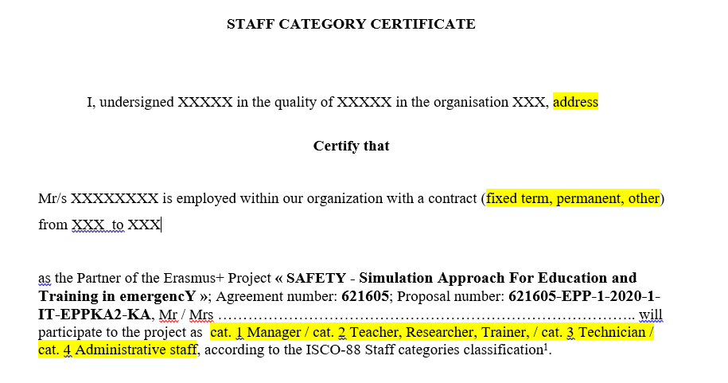
Staff certificates (b)
Staff certificates must be provided once per each worker, at the beginning of the project or when the staff member starts working on the project.
The template will be provided by Valuedo. Here blow the example of this document:

Slide 29
Time-sheets (1)
Documents justifying actual number of eligible units for project implementation support
Proof of number of days worked: Time-sheets.
On request or in case of audit the partners must be able to present extracts of the analytical accounts (Focus 4: Internal time-sheet system) showing the actual time dedicated to the SAFETY project: this is important for the organizations participating in several projects to avoid double funding.

Slide 30
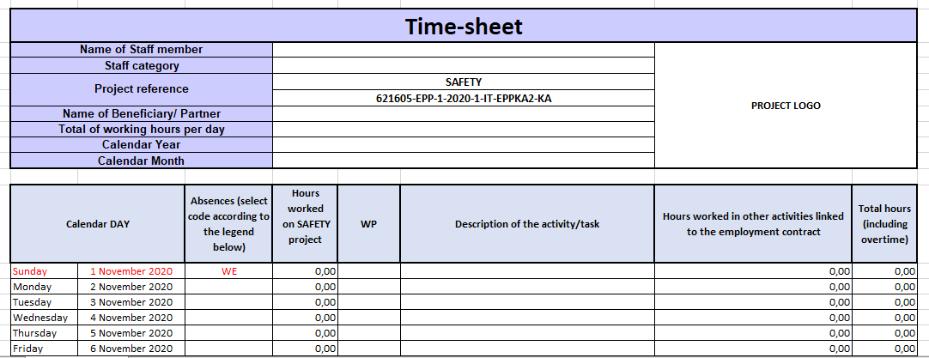
Time-sheets template
Number of working hours per day: it is related to the number of hours established by the national collective agreement adopted by the organization for the individual contract of the workers.
The excel file automatically calculates the equivalent number of working days according to the number of hours worked on the project (total number of hours worked divided by the total number of working hours per day – collective agreement)

Slide 31
Reporting process
Partners must provide on a quarterly basis the time-sheets (1) and supporting documents (2 and 3).
Sending the timesheets in .xls format to UNIFG and ValueDo Valuedo to check the timesheets under a formal point of view and provide the partners with feedback and possible corrective actions;
Sending the scanned copies of the final/revised version of the timesheets signed by both the worker and the Project Manager/Administrative responsible to UNIFG and Valuedo.
🡪 ValueDo to upload them in Gdrive (Management; Time-sheet partners)
Sending by email to UNIFG Financial Manager (fedele.colantuono@unifg.it):
- Scanned copy of the supporting documents
EVERY SIX MONTHS: Sending by mail the certified copies of the time-sheets:
      Writing 'Certified to be a true copy of the original seen by me' on the document;
      Signing and dating it;
      Writing the name under the signature
To the following address: @ dipartimento Fedele

Slide 32

Financial reporting
Deadlines | Reporting Period
1st FR: | 08.02.2021
2nd FR: | 07.05.2021
3rd FR: | 09.08.2021
4th FR: | 08.11.2021
5th FR | 07.02.2022
6th FR | 09.05.2022
7th FR | 08.08.2022
8th FR: | 07.11.2022
9th FR: | 06.02.2023
10th FR: | 08.05.2023
11th FR: | 07.08.2023
12th FR: | 06.11.2023
In the Partner agreement the partners agreed to follow the proposed process:
Sending certified copies
Sending certified copies
Sending certified copies
Sending certified copies
Sending certified copies
Sending certified copies

Slide 33
Other documents supporting staff costs
Documents justifying the eligible activities
You need to keep:
Proof of activities and outputs produced: leaflets, brochures, reports, analytical papers, presse releases, websites, social media outputs.
Keep all the supporting documents (including invoices) relating to partners’ activities/outputs
Proof of partnership meeting: for partners 🡪 individual travel tickets; for coordinator 🡪 agenda, attendence list signed by participants, minutes, reports, evaluation of the meeting.
All the documents must be kept for 5 years

Slide 34
Tips about staff costs
The employment contract defines, in its text, the category that should be taken as reference for claiming the working days under one of the categories set in the call/action/template. The official reference is the ISCO-88 staff categories classification
Flexibility between categories is allowed as far as this flexibility is not deviating from a proper, careful and wiser care and to a cost-efficient approach in the allocation of tasks/days;
It should be avoided requesting flexibility to take advantage of the Unit cost system.

Slide 35
Which other documents should be kept?
In case of events/meeting/conferences:
  Proof of events/conferences: final programme, invitations, list of invitees/mailing list;
  list of attendence signed by particpants;
  material for conferences (papers, presentations, leaflets, videos..);
  output of the conference (reports, web-sites, evaluations, pictures..);
  These documents will be asked by INFOTECH, WP9 Leader

Slide 36
To sum up
All the partners must sent to UNIFG and ValueDo for each staff member:
Employment contract
  To send it just when you report a staff member for the first time (or when changes arise)
Staff category certificate
  To send it just one copy when you first report the staff member (or when changes arise)
All the partners must provide quarterly per each staff member involved in the project the following documents:
Time-sheets
  To send by email to UNIFG and Valuedo first in Excel file;
  when validated, to send the the scanned copies (.pdf) with signatures to UNIFG and Valuedo
Payslips – to send by email only to UNIFG
Proofs of payment - to send by email only to UNIFG
Every six months each partner to send to UNIFG certified copies of the timesheets
Partners only report staff costs – but carry out regular accounting and keep all the invoices and other financial documents regarding all project costs in case of audit - partners show that other project costs were at least equal to the received grant

Slide 37
Sub-contracting
If during the implementation of a project, the beneficiaries proceed with subcontracting activities they shall ensure that:
asks/activities subcontracted only cover the implementation of a limited part of the action;
the beneficiaries ensure that the conditions applicable to them in the grant agreement are also applicable to the subcontractor;
any possible conflict of interest is avoided;
Sub-contracting costs can not be reported

Slide 38
Budget Changes
Internal transfers within categories is always possible if the quality of outcomes of the activities listed in the approved work plan is not modified.
It is possible to change the budget structure without an amendement if:
It is a reaction to a situation
It is an initiative to add value to the project implementation and outcomes
It involves a transfer between staff categories (e.g from staff cat. 1 to staff cat. 2). Please always inform the Coordinator
It involves changes in the allocation of WDs for WPs. Please always inform the Coordinator
It requires an amendment if it involves:
Budget transfer between Partners / transfer of tasks and responsibilities

Slide 39
Calculation of the final EU grant
The coordinator shall report on the project activities and results on behalf of the project as a whole, specifying all the elements necessary to appreciate the reality of the generating event. The payment will be done according to the following events:
  implementation of the activities in accordance with the description annexed to the grant agreement or decision;
  actual number of units consumed, produced or exploited, linked to the unit cost rate and related to eligible activities following the conditions mentioned above.
The final amount of a grant in a simplified form is therefore to be calculated by multiplying the pre-established amounts to the actual eligible units with the unit costs presented before.

Slide 40
Reduction of the final grant in the event of weak implementation
The Agency shall reduce the amount of the final grant relating to the staff costs in the event of weak implementation of the action. Those reductions/penalties, in respect of low performance, are applied at the level of the final grants.
Poor, partial or late implementation of the project will be established by the Agency on the basis of:
  the final report submitted by the coordinator and
  the products and outputs produced by the project.
A reduction may be applied to the grant initially provided for of:
  25% if the final report scores at least 40 points and below 50 points;
  35% if the final report scores at least 30 and below 40 points;
  55% if the final report scores at least 20 and below 30 points;
  75% if the final report scores below 20 points.
The Agency may consider also information received from any other relevant source, proving that the project is not implemented in accordance with the contractual provisions. Other sources of information may include monitoring visits, desk checks or on the spot checks undertaken by the Agency.

Slide 41
Contents
Administrative procedures
Monitoring of the projects by the Agency
Audit Process in the EACEA
Application form amendments

Slide 42
1. Monitoring of the projects by the Agency
What kind of monitoring?
Performance oriented monitoring (Interim Report – M18) 🡪 first half of the project lifecycle; it is focused on the way the projects is being managed, how the consortium is cooperating and if the activities are being implemented according to plans.
Result-oriented approach (Final Report – M36) 🡪 second half of the project; it is focused on the produced deliverables, their outreach, future exploitation and sustainability.
How?
Agency’s desk monitoring 🡪 Interim and Final Report
Agency’s monitoring visitis in situ 🡪 any time at the premises of the coordinating organization or during one of the partnerhsip Meetings

Slide 43
2. Audit Process in the EACEA
Audits are foreseen and performed based on the Annual Audit Plan
10% of audits relate to the grant projects and most of audits are performed by the external auditors;
Audit can be launched up to 5 years after closure of the project by the final payment or recovery order.

Slide 44
3. Application form amendments
An amendment is an act modifying the grant conditions initially agreed or established in clauses of the gran agremment. Any amendment must be subject to a prior written supplementary agreement (no retroactivity!).
Changes which require an amendment:
  Change of the coordinating organization;
  Change in partnership: withdrawal of beneficiaries;
  Change in partnership: new or replacing beneficiaries joining the project;
  Changes to the eligibility period;
  Change of Lead Partner bank account;
  Changes to the work programme.

Slide 45
3. Application form amendments (2)
Changes which do not require an amendment:
  Change of the legal status;
  Change of legal name;
  Change of address.
You can change the information directly via the Participation Portal: https://ec.europa.eu/education/participants/portal/desktop/en/home.html
Please inform UNIFG and ValueDo about any change should happen.

Slide 46
LAST MINUTE TIPS
Read and re-read the
Grant Agreement
and the relevant Annexes

Slide 47
THANK YOU FOR YOUR ATTENTION

