Slide 1

SAFETY
Simulation Approach For Education and Training in emergencY
WP1 description
Desk Research on HEIs training offer and simulation activity for Emergency Training
The European Commission support for the production of this publication does not constitute endorsement of the contents which reflects the views only of the authors, and the Commission cannot be held responsible for any use which may be made of the information contained therein

Slide 2
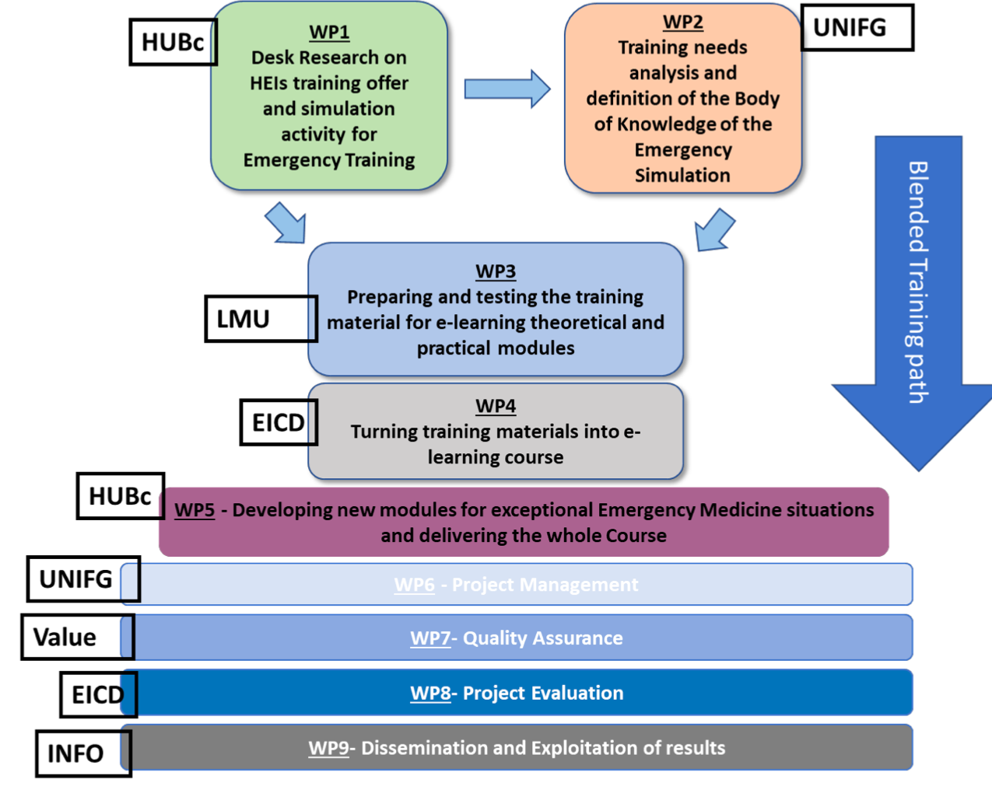


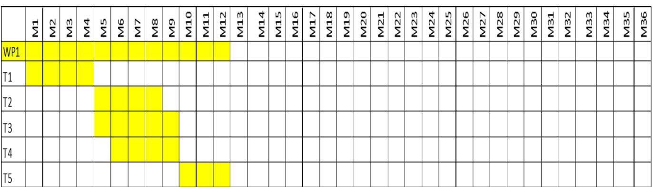


Description, aims, organization of the work
Offer
starting point
Design and Plan
HEIS educational offer
Research
Literature
Research
Good practices
Research
Inform

Slide 3

Tasks
Distribute tasks
Representative and Information tracker member
Verify completion
Communicate the progress
Ensure database compliance

Slide 4




Tasks
Anaesthesia
Emergency
Cardiology
Obstetric
Universities’ offer
Paediatrics
Hospitals’ offer
Universities and
Hospital’s list
Scientific societies
Surgery
Simulation
Emergency services’ offer
Critical Care
Pre Hospital
European Resuscitation Council

Slide 5
Tasks
%Theory/Practice
Simulation yes/no
Material, type of simulation
Online advertisement
Mandatory/optional
Private/Public/Both
Main emergency topic
Ways of final evaluation
Frequency
Hours/Credits
Final certification?
Online/Blended/
Classroom course
% Technical skills/ n
Non technical skills
Syllabi features
Type of Information
Accessibility
Number of students
Students’ characteristics
Admission requirements
One specialty /Multidisciplinary
Price
Address to: Undergraduate /postgraduate/fellow/specialists
Location (Simulation centre, Hospital, University)
Online Syllabi

Slide 6
Tasks
1
2
Online available information
Direct contact
https://www.ssih.org/Home/SIM-Center-Directory/Area/EUROPE (European simulation centres)
https://www.eurosim.info/societies/uksim (European simulation societies)
https://healthcare-in-europe.com/en/news/simulation-training-in-europe.html (Simulation training in Europe)
https://www.sesam-web.org/centres/ (Society for simulation in Europe)
https://eua.eu/about/member-directory.html (European universities)
https://eua.eu/about/working-groups.html (European simulation groups)
Mail
Survey
How?

Slide 7

Results

Slide 8
Link with the other WPs
WP2
WP5
WP4
WP3
Offer
starting point

Slide 9
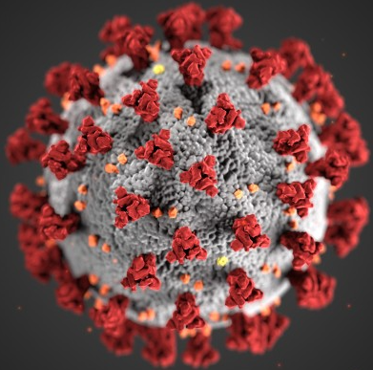
Beyond the project proposal: Suggestions
How the educational offer has been changed since..

