Slide 1

SAFETY
Simulation Approach For Education and Training in emergencY
WP5 description
Developing new modules for exceptional Emergency Medicine situations and delivering the whole Course
The European Commission support for the production of this publication does not constitute endorsement of the contents which reflects the views only of the authors, and the Commission cannot be held responsible for any use which may be made of the information contained therein

Slide 2
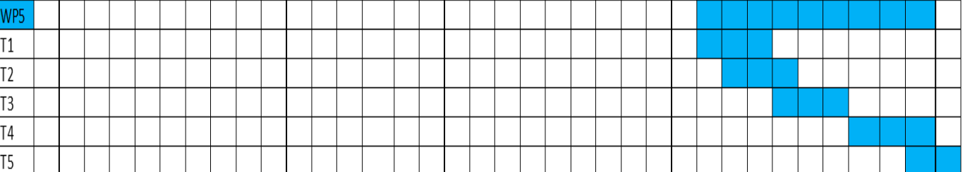



WP5 description, aims, organization of the work
Non Technical Skills module
The team does not have promptly ready one of the professional component
presence of patient’s panicked relatives
Developing material
Team
Developing material
Relative
E learning
Improvment
Handbook

Slide 3
E-learning
The training material will have the following essential characteristics:
  Clear division of topics
  All material in English
Materials will be composed of various media (texts, infographics; power-point slides, tests and quizzes, tests to verify learning effects related to the contents of each module).
It will provide:
  3 scripts for situations in which the doctors are missing
  3 scripts for situations in which the nurses are missing

Slide 4
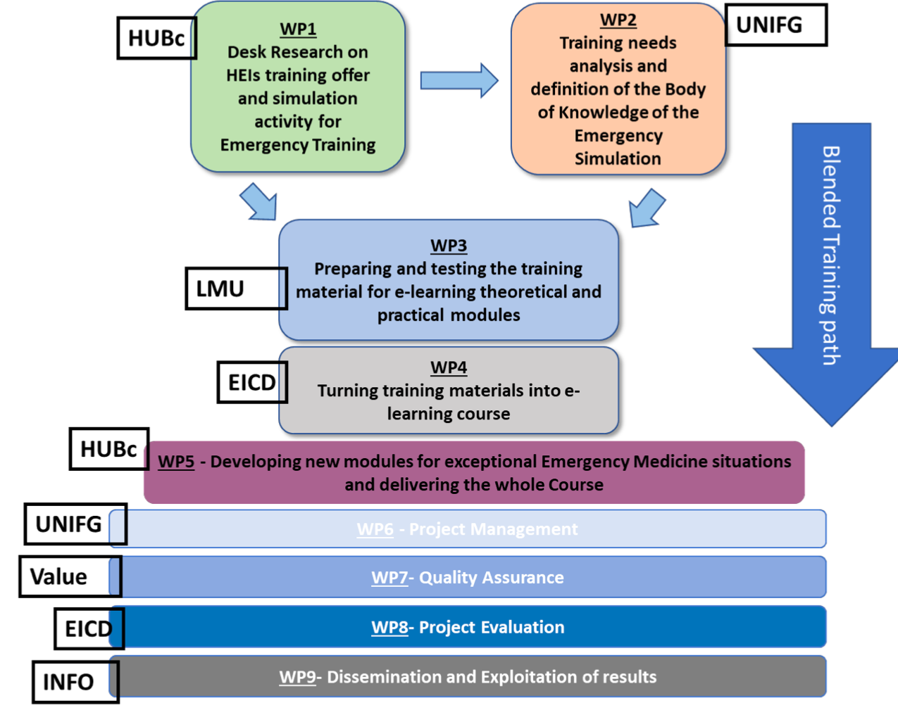
Link with the other WPs
Action plans, training materials and evaluation methods developed in WP3 and WP4 will be adapted to this new output.
This new material will consist of two additional practical modules and will be appended to the ones developed in WP4.

Slide 5
Beyond the project proposal: Suggestions/improvements
To assess the performance gap before and after the implantation of the module.

