Slide 1


Work Package 2 – Training needs analysis and definition of the Body of Knowledge of the Emergency Simulation
Francesco Barberio and Fedele Colantuono (UniFg)
The European Commission support for the production of this publication does not constitute endorsement of the contents which reflects the views only of the authors, and the Commission cannot be held responsible for any use which may be made of the information contained therein

Slide 2



WP2: training needs and gaps
WP2 Objectives:
Bring out the training needs in the field of Emergency HEI and private education
Develop ad-hoc questionnaires and interviews for each target group
  Students
  Academics
  Companies
Comparison of the WP1 results with the results emerging from investigating the target groups
Educational solutions
BODY OF KNOWLEDGE (BoK)
WP1: educational offer and good practices
Body of Knowledge

Slide 3
This WP will produce the following results:
Action plan for the survey for students and Academics (R2.1) - M4
Action plan for the semi-structured interviews for entrepreneurs (R2.2) – M4
Ad-hoc questionnaires (in R2.1 – R2.2) - M4
Training Needs Analysis (State of the art of the training needs required for prospective new doctors, nurses, psychologists and simulation device developers) (R2.3) – M11
Production of the BoK upon which to reform the existing academic pathways based on simulation training (R2.4) – M13

Slide 4
TIMELINE
Action plan for needs analysis for students and academics
Student questionnaire
Questionnaire for academics/experts
Validation with others partners
Test pilot for both questionnaires on a representative sample
Action plan for companies needs analysis
Questionnaire for companies
Validation with others partners
Test pilot for questionnaire partner companies Survey to students and academics
Report with the needs analysis emerging from the surveys
Gaps analysis e BoK
Survey to companies
M2-M4 (Dec-Feb)
M3 - M5 (Jan - March)
M5- M8 (March - June)
M9- M13 (July - Nov )

Slide 5
How the partners will contribute to WP2 ?
Universities: they will design the questionnaires and conduct the investigation, prepare the gap analysis and the BoK .
Companies: they will participate in interviews and/or semi-structured questionnaires with the aim of stating their main needs when hiring new potential workforce.
Associate partners: their active involvement will prove vital to widen the number of students and academics taking the surveys.

Slide 6
Action Plan for the survey for Students and Academics (T2.1)
Identification of national coordinators of the research in each partner country;
Identification of the key topics the investigation should stick to;
Methodologies leading the surveys;
Target to reach;
Duration of the data collection, indicating an intermediate deadline to validate the surveys;
Template to report the results
M2-M4 (Dec-Feb)
(first draft by the mid. of Jan.)

Slide 7
Action Plan for the semi-structured interviews for Entrepreneurs (T2.2)
Identification of national coordinators of the research in each partner country;
The company profile to investigate;
Methodologies leading data collection;
The indication of the key topic to address with the survey;
Duration of the data collection, indicating an intermediate deadline to validate the surveys;
Template to report the results.
M3 - M5 (Jan - March)
(first draft by end. of Jan.)

Slide 8


Slide 9
STUDENTS target group 18-30 years Young Adults
the need to know
the learner's self-concept
the role of the previous experience (and previous instruction)
the orientation towards learning
the motivation
(Malcom Knowles, 2008)

Slide 10
QUESTIONNAIRE for students (T2.3)
Understand the perception/view they have about the current educational offer;
Understand the perception/view they have about their Technical Skills acknowledges;
Understand the perception/view they have about their Non-Technical Skills acknowledges;
Understand the perception/view they have about their Team Management acknowledges
Understand if they ever used before simulation tools and if they think it’s useful
… in the field of EMERGENCY…

Slide 11
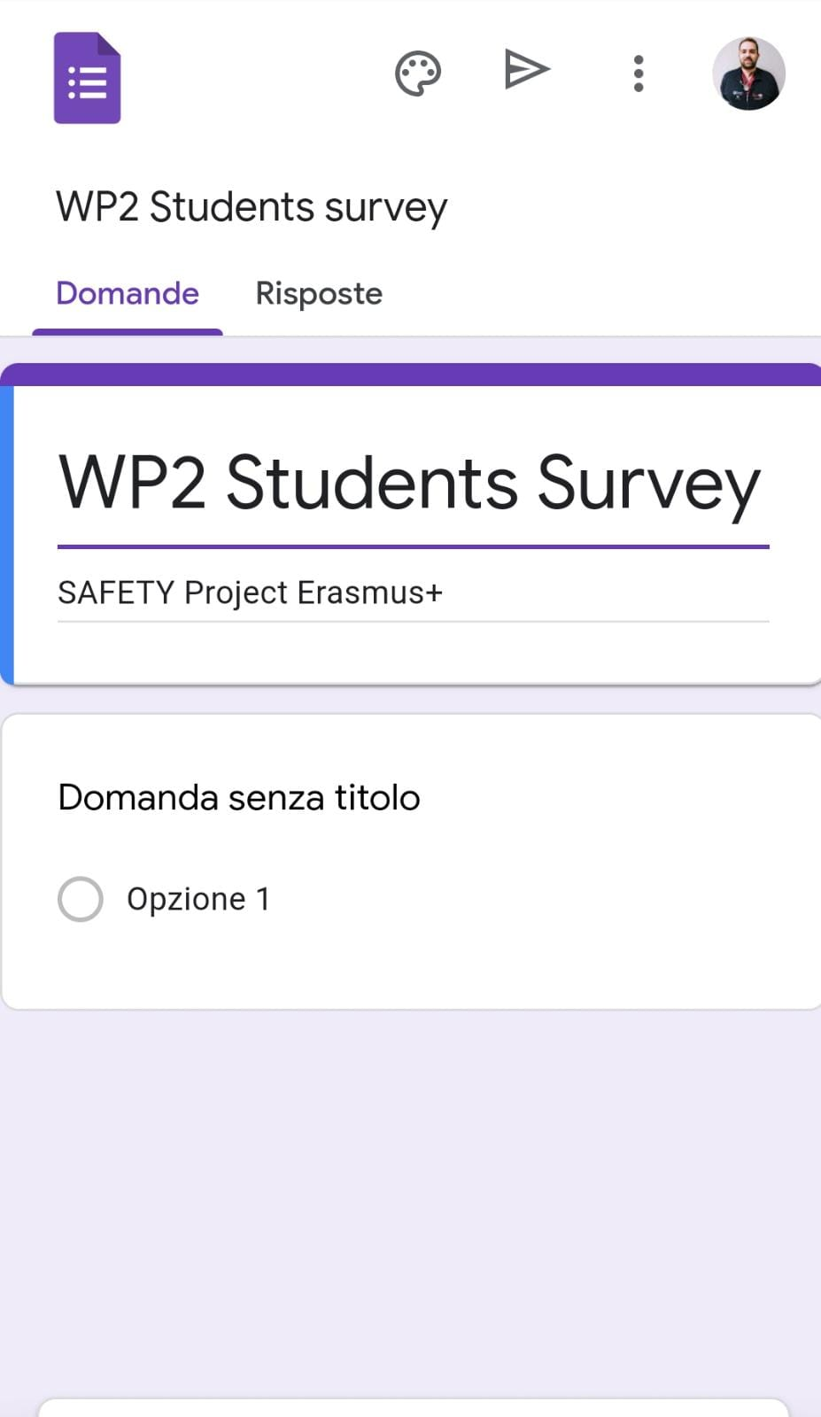
Questions about actual educational offer;
Questions about learner's self-concept preparation;
Questions about Technical Skills acknowledges;
Questions about Non-Technical Skills acknowledges;
Questions about Team Management acknowledges;
Using a 5 points “Likert Scale”
  From Not at all to A lot
M3 - M5 (Jan - March)
(first draft by mid. of Jan.)

Slide 12
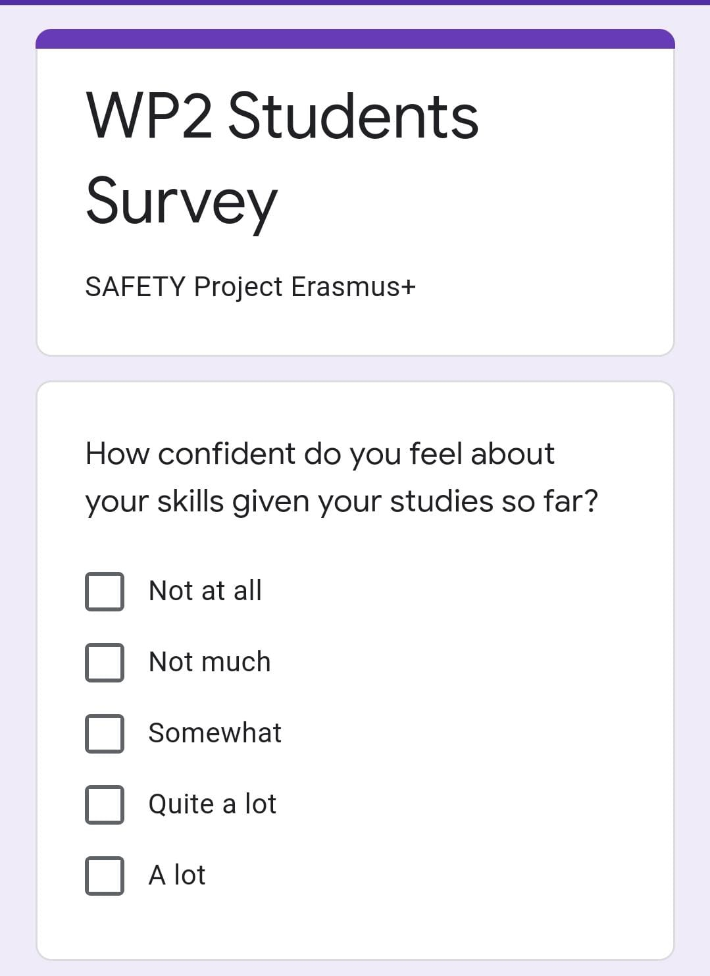
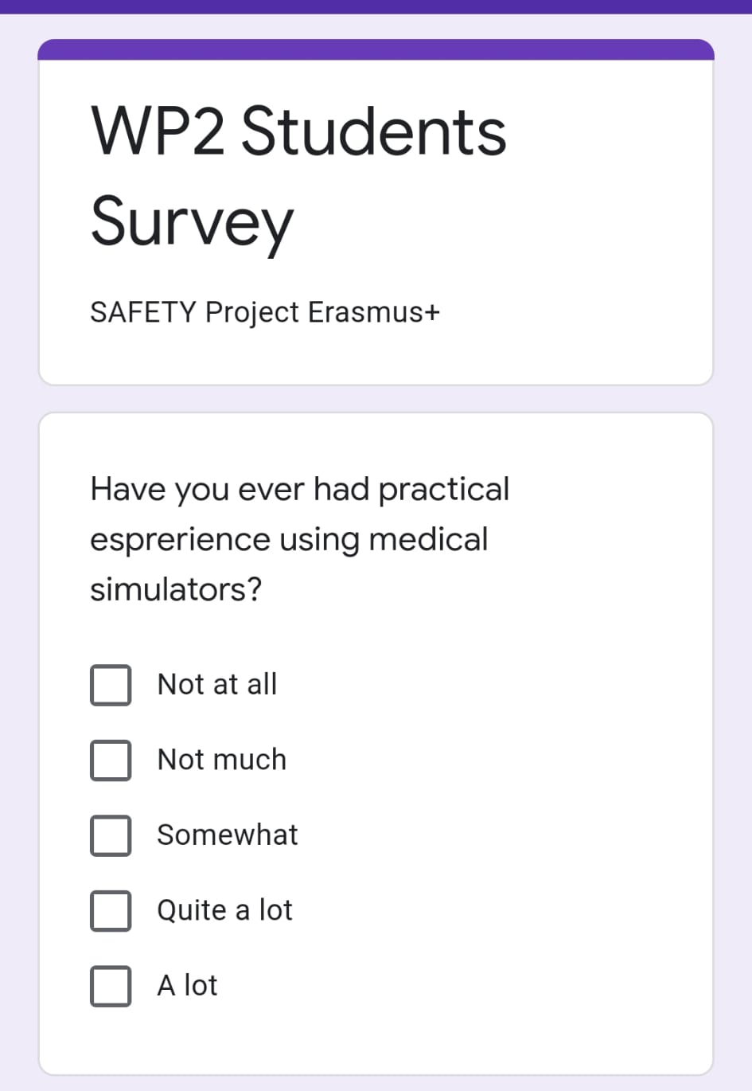
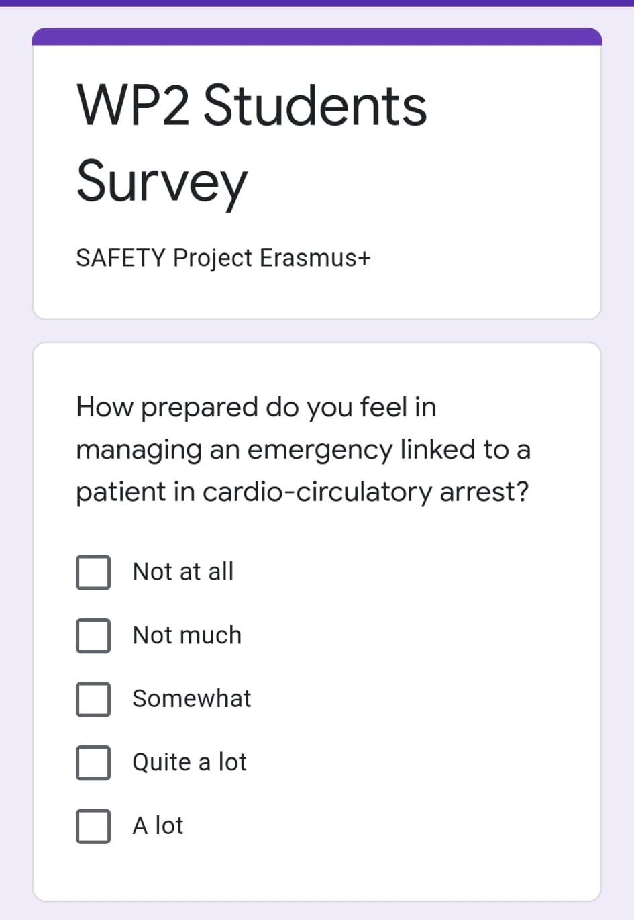

Slide 13
TEST PILOT (by mid. Feb.) and EXPECTED RESULTS
Students of the Universities involved in the project
Associated partners of students associations

Slide 14
ACADEMICS target group: Teachers and Researchers
Experts in their field of competencies
Already working in the healthcare fields
Previous “desk teaching” method
Experiences acquired directly on the patient
Often not confident with simulation methods

Slide 15
QUESTIONNAIRE for academics (T2.3)
Understand the perception/view they have about the current educational offer;
Understand the perception/view they have about their Technical Skills teachings;
Understand the perception/view they have about their Non-Technical Skills teachings;
Understand the perception/view they have about their Team Management teachings;
Understand if they ever used before simulation teaching and if they think it’s useful
… in the field of EMERGENCY…

Slide 16
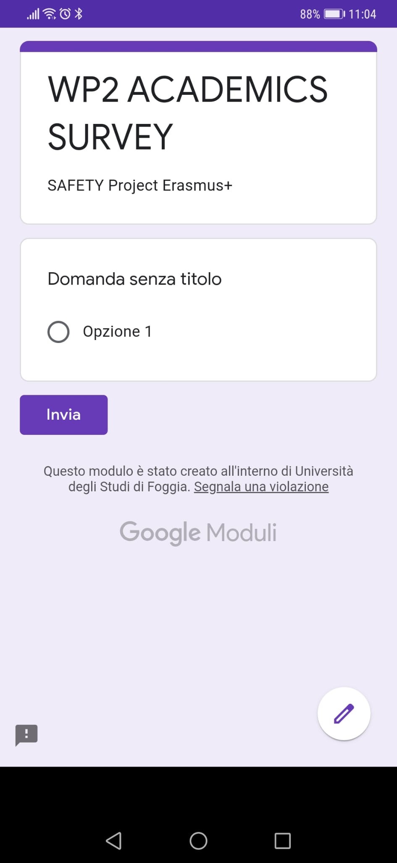
Questions about actual educational offer;
Questions about learner's preparation;
Questions about Technical Skills teachings;
Questions about Non-Technical Skills teachings;
Questions about Team Management teachings;
Using a 5 points “Likert Scale”
  From Not at all to A lot
M3 - M5 (Jan - March)
(first draft by the mid of Jan.)

Slide 17
TEST PILOT (by mid. Feb.) and EXPECTED RESULTS
Academics of the Universities involved in the project
Eventually Academics from other Universities

Slide 18



ENTERPRENEURS target group: Companies developing simulation tools
Experts in their field of competencies
Medical Knowledge
Practical understanding of lab instrumental
Ability to coach and develop training programs about using simulation tools
Understanding and participation on improving efficiency and reliability of the tools and equipment

Slide 19
QUESTIONNAIRE for entrepreneurs (T2.4)
Understand the perception/view they have about the current educational offer;
Understand their actual application in the field of Emergency in the Universities;
Understand their actual application in the field of Emergency outside Universities scope;
Understand their needs to implement their offers;
Understand how to allow greater integration between this type of companies and the Universities
Understand skills and requirements for personnel to hire

Slide 20
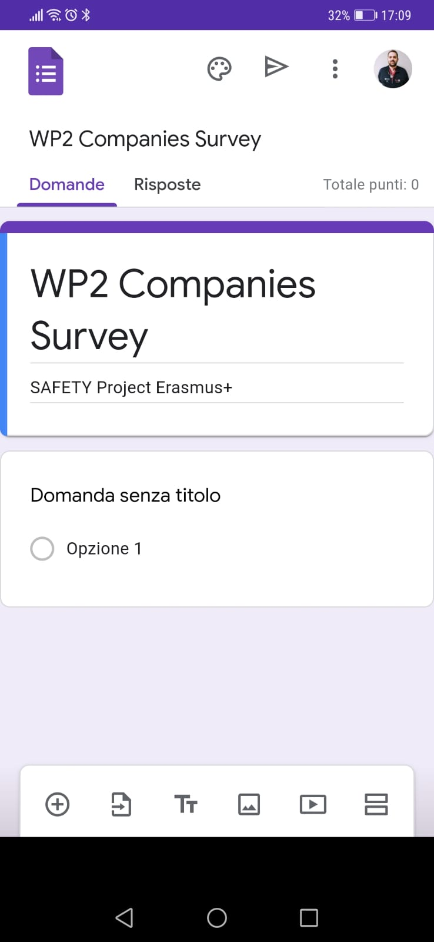
Questions about actual involvement in educational offer;
Questions about their needs;
Questions about their perspectives;
Questions about their improvement in healthcare education;
Questions about their integration in standardized educational programs;
M5- M8 (March - June)
(first draft by the mid of Feb.)

Slide 21
T 2.5 Identifying the training needs and training needs analysis
At least 500 feedbacks from students
At least 80 feedback from academics
Final number defined according to
companies availability
Needs analyses for all groups;
Existing gaps between different conception of the degree of preparation received/provided;
Preparation of a report composed of two main sections: data repository (from all questionnaires ) and training needs (R2.3).
M9 – M11 (July – Sept.)
(first draft by the end of August)

Slide 22
T2.6–Undertaking gap analysis and Body of Knowledge development (leader UNIFG, UiS main support, University and company partners for validation)
Report with the needs analysis and BoK (R2.4)
Present the gap analysis aimed at unveiling distances between the optimal pathway to undertake according to the Desk researches developed throughout the WP1 and the training needs pointed out by the target groups. It will show the gaps balanced according to the different views investigated within WP1 and WP2.
The main section will detail the knowledge, competencies and skills to be developed in order to fill the gaps presented in the introductionary section.
The solutions illustrated in this section will represent the ones to be turned into the new course(s).
M9- M13 (July - Nov )
(first draft by the end of Oct.)

Slide 23
Thank You
The European Commission support for the production of this publication does not constitute endorsement of the contents which reflects the views only of the authors, and the Commission cannot be held responsible for any use which may be made of the information contained therein

