Slide 1




WP 8 – ML 6 external evaluation
Project evaluation
Predoi Cornelia , EICD
The European Commission's support for the production of this publication does not constitute an endorsement of the contents, which reflect the views only of the authors, and the Commission cannot be held responsible for any use which may be made of the information contained therein.

Slide 2

Initial plan
A list of 6 Independent evaluators (3 selected by the Steering Committee)
At least 2 external evaluators for ML6
Letter of invitation for the evaluators
Use of a semi-structured questionnaire
Predoi Cornelia, 28.11.2023, Barcelona Page 01

Slide 3
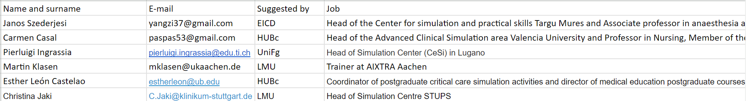
6 propositions
Predoi Cornelia, 28.11.2023, Barcelona Page 02

Slide 4
Selection of the external evaluators
we have to select 2
each evaluator will be sent an invitation letter
Predoi Cornelia, 28.11.2023, Barcelona Page 03

Slide 5
Letter of invitation - content
Short introduction about SAFETY
General objectives
Target groups
Description of the workpackages
Description of the milestones which are object for external evaluation
Method used for evaluation (semi structured questionnaire)
Time and place of evaluation
Predoi Cornelia, 28.11.2023, Barcelona Page 04

Slide 6
External evaluation done by students
8 for each partner – a total of 40
Each partner should complete the excel file with the 8 external students names
Predoi Cornelia, 28.11.2023, Barcelona Page 05

Slide 7
Proposed deadlines
        EICD to prepare a draft of the invitation letter – done
        EICD to prepare a draft of the semi structured questionnaire – done
        EICD to collect feedback / approvals to run the MLs assessment by – 15.12.2023
        Depending on the decisions, approach to the external reviewers will be carried out during December, establishing the right time window for the interview
        Obtaining the results of questionnaires by 20th of January
Predoi Cornelia, 28.11.2023, Barcelona Page 06

Slide 8

Thank you!

