Slide 1


SAFETY Project updates and considerations on midterm report
…………………………….
Fedele Colantuono, UniFg
PRESENTATION TITLE
and subtitle
…………………………….
Speaker name, Partner

Slide 2
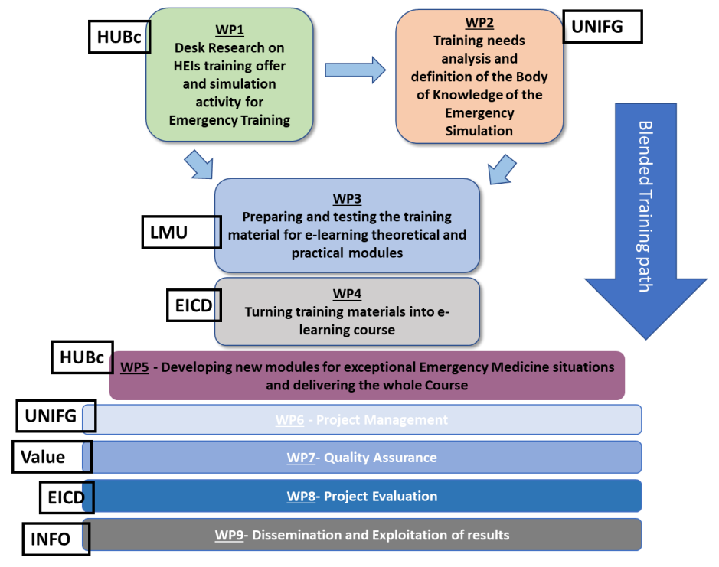
Our logical framework…

Slide 3
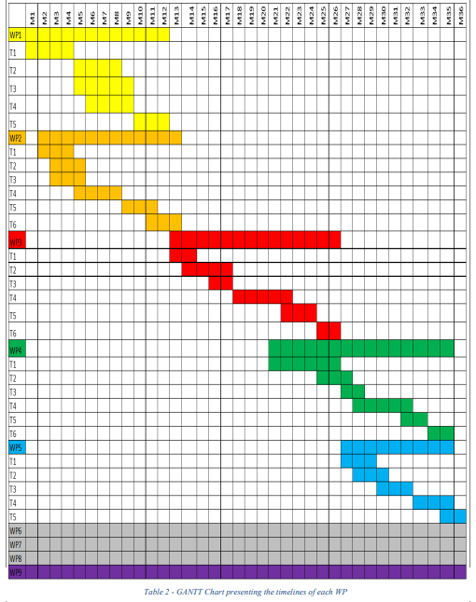
Where we are…

Slide 4
Considerations on midterm report
Relevance of the project - EU Policy Relevance. Score: 5
The interim report does not show sufficient progress in the aims and objectives of the knowledge alliance. However, the project activities that have been implemented are in accordance with the initial aims as stated in the application.
ACTION: to show sufficient progress in the aims and objectives of the knowledge alliance, concrete activities and/or results that demonstrate the European added value of the project.
ACTION: The concrete activities itself must be implemented in the second phase of this Knowledge Alliance.
ACTION: add supporting documents to the products and outcomes for WP 1, 6,7,8,9 in the report, although available online.

Slide 5
Relevance of the project - EU Policy Relevance:
Facebook, Twitter and Instagram are working, this is not the case for Youtube (link does not work).
ACTION: verify Youtube link and populate it with videos
The EU added value can only be evaluated and assessed after the second project phase.

Slide 6
2. Quality of the project design and implementation Score: 7
2.1. Quality and coherence between Work Packages (WP) and delivered activities/products
ACTION: to proof that the planned deliverables comply with high quality and innovative standards.
Quality assurance
ACTION: all learning materials must be freely accessible for non-commercial purposes as Open Educational Resources on the project website (in the learning section) and YouTube channel.
possibility to develop MOOCs for enlarging the audience
ACTION: to develop a specific plan for the MOOCs

Slide 7
2. Quality of the project design and implementation
More attention should be paid to the sustainability of the project.
ACTION: develop a specific strategy that will ensure that additional funds will be secured with the existing partners or other potential end-users, e.g. enlarging the action in developing countries.
Financial management seems ok, working days and financial resources are distributed in accordance to the work carried out by each partner and for each work package.
ACTION: The only point of attention is the fact that all the working days for WP 3 and WP 4 should be used according work plan.

Slide 8
3. Quality of the project team and the cooperation arrangements Score: 8
The partnerships seems to work in an effective way. The involvement and commitment of partners is clear.
There was a good number of participants in the online survey on training needs which shows the high interest of stakeholders in the project's activities and results. Important help was received from the Associated Partners, with whom there was an important collaboration in data collection. Also, the university-business connection was strengthened by during the first phases of project development, thanks to the involvement of external companies and associations specialized in the field of emergency and simulation as associated partners.
ACTION: all partners have to keep the network alive, continuing to involve external experts, companies and stakeholders, organizing events, initiative to increase project visibility, improve quality of the results and ensure exploitation.

Slide 9
4. Impact and dissemination. Score: 6
The dissemination plan lacks a clear description on how the target groups have effectively been reached and involved.
Different tools and channels are mentioned but do not show evidence about the results that have been made.
The website does not contain all results and the Body of Knowledge is still under construction. This is also the case for the Youtube movies. Overall, the project's website is attractive, user friendly and of good quality.
ACTION: solve the dissemination lacks and in the next report clearly show that the results and outputs have been exploited by the partners (and beyond the consortium).

Slide 10
4. Impact
At this stage, no real significant impact can be identified for the main target groups.
ACTION: The possible impact should be clearly visible after the development and use of the outputs of WP3 and WP4. The project could possibly provide inputs for policy developments e.g. at local, regional, national or European levels.
Publishable results on the Erasmus+ project results platform
ACTION: After the implementation of WP3 and WP4 the results could be published on the platform.

Slide 11
Overall comments
Main strengths
The possible outreach and impact could be great.
Management is well organized.
Financial management is properly described.
Main weaknesses
The development and implementation of WP 3 and WP4 is lagging behind.
The sustainability of the project lacks focus and a clear action plan.
Not all the outputs are open access.

Slide 12

Thank you!

